Slide 1
Parent/carer Information Meeting
Sacred Heart Catholic Primary School
Autumn 2022
Year 3 St Martin - Miss Smith
Year 3 St Bernadette - Miss Walker

Slide 3
Leadership Team
Mr. Lane – Executive Headteacher
Mrs McCormick – Deputy Headteacher
Miss Le Fleming, Mr Rodrigo and Ms Brown– Assistant Headteachers

Slide 4
St Martin
Miss Holloway – Learning Support Assitant
Miss Fennell – 1:1 Learning Support Assisstant
Mrs Smith Learning Support Assistant
St Bernadette
Mrs Smith - Learning Support Assistant
Miss Hegley – 1:1 Learning Support Asssistant

Slide 5
Information
You can find out what is going on in school/class in several different ways:Website - www.sacredheart.islington.sch.uk
Curriculum/topic maps
Twitter account : SacredHeart_CS
Class assemblies
Parent’s evening (Autumn & Spring terms)
End of year reports (Summer Term)
Notes/letters sent home
Text messages (ensure school office has up to date details)
Weekly newsletters (and put on the school website)

Slide 6
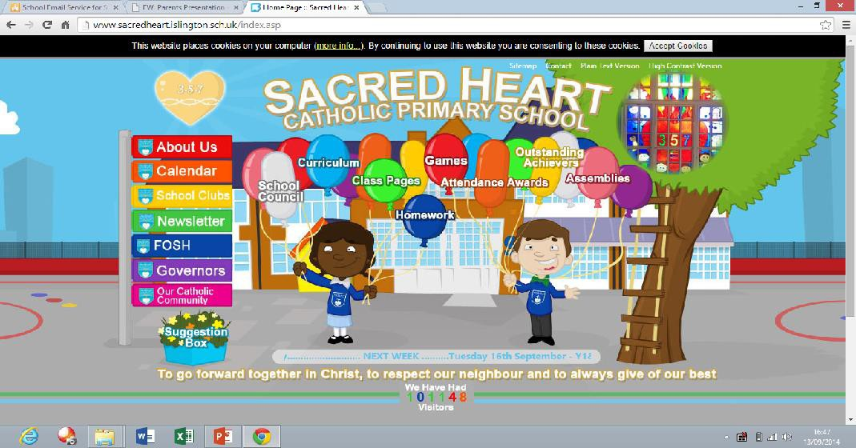
http://www.sacredheart.islington.sch.uk/

Slide 7
Subjects we study
Religious Education
English (Reading, Writing, Handwriting, Grammar, Punctuation and Spelling)
Maths
Science
History /Geography (half termly basis)
Art/Design Technology (half termly basis)
Computing ( Taught by specialist teacher)
Music (Taught by specialist teacher)
Spanish (Summer Term 2)
Physical Education
Personal, Social, Health, Citizenship and Emotional Education

Slide 8
Religious Education Topics

Slide 9
Year 3 Curriculum Topics

Slide 10
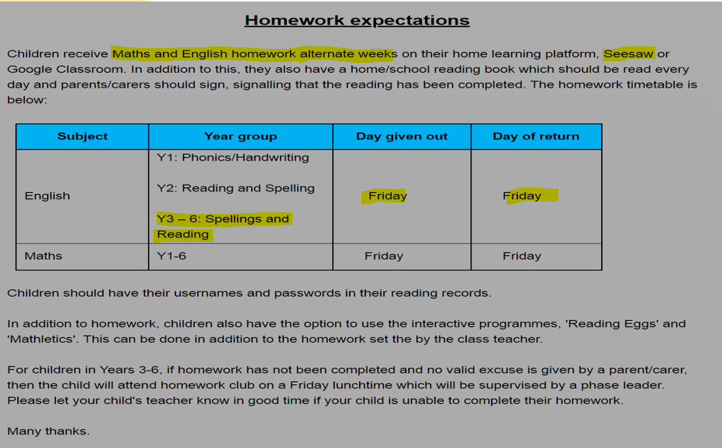
Homework
Homework will start on Friday 16th September

Slide 11
Reading
In addition to the weekly homework, the children will be expected to complete daily reading from Monday- Friday. Expectations are as follows:
LKS2 – Year 3
20 minutes per night
Please ensure that you sign your child’s Reading Record daily and comment if there is something you would like the teacher to know or when responding to a comment from the teacher. Your role in your child’s development of reading is crucial so please sign the Home/school Reading agreement which you will find at the front of your child’s Reading Record.

Slide 12
Home/School reading
Child to read to parent and vice versa.
Parents to ask children questions about what they have read.(There are suggested questions in the ‘Helping your child with English’ document which can be found on the school website, as well as home learning resources and suggested reading lists. Some books may have suggested comprehension questions listed at the back.
Parent to sign, adding a comment is optional although please let us know any concerns you have or anything you feel is significant about your child’s reading.
3x Book Not Signed (BNS) – Children will be asked to read during their H/W club on Friday.
Banded book levels – children should be able to read 95% of the book confidently to build up their confidence. As well as this, children need to be able to understand what they are reading.
Your child’s reading level may have changed moving into Year 3 as we change from coloured book bands to numbered book levels.

Slide 13
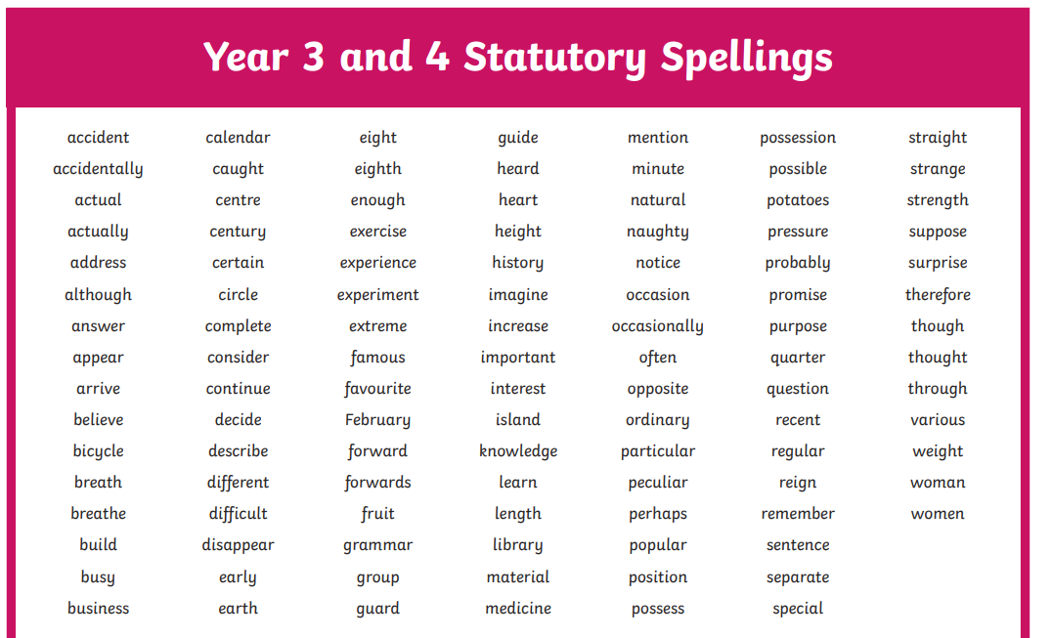
Spelling
Please take note of the Spelling word lists as your child needs to be able to read and spell these by the end of Year 4 (at the end of the key stage).

Slide 14
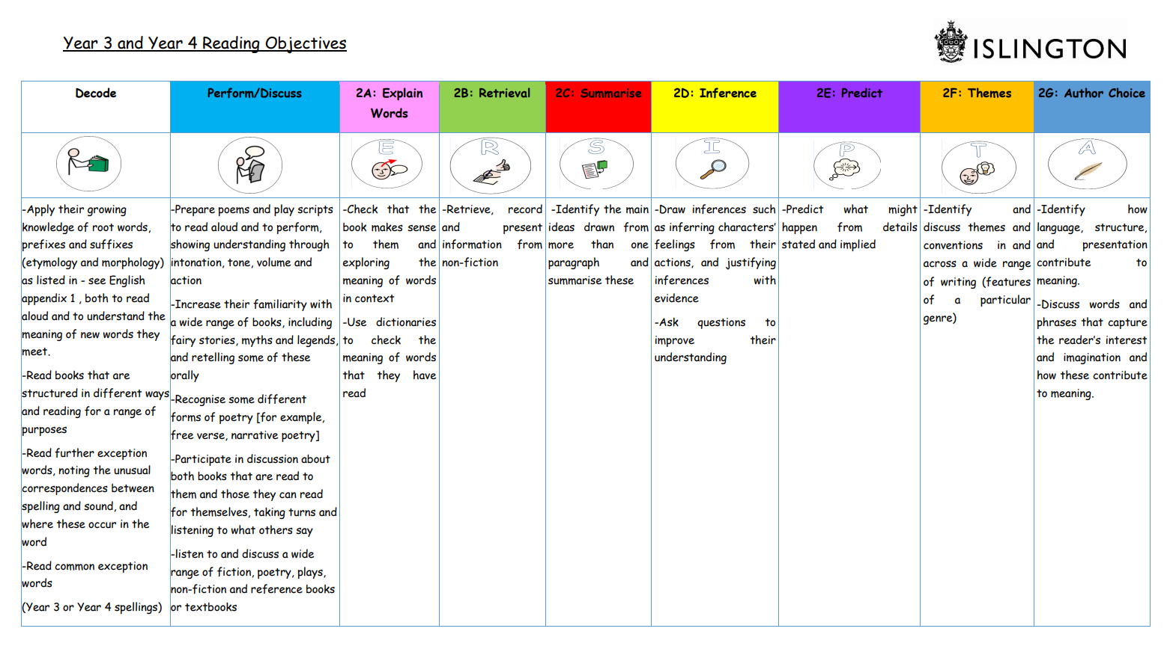
Comprehension Skills
These skills are covered in whole class guided reading at school but can be helpful to know to practise for home reading comprehension too!

Slide 15
Times tables
Children need daily practice with their times tables in order to really remember them.
They only truly know them when they can fluently recall them out of order and when they can apply them in order to solve problems.
Children practise their times tables during Maths lessons and complete times table challenges but by this stage, the children should know them so we can use the lessons to apply them in reasoning and problem solving.
There is guidance on the school website (under curriculum) for how to support your child with learning times tables.
In Year 3, your child is expected to know up to 2,5 and 10 confidently from year 2 and will learn 3,4 and 8 throughout year 3 and use them in a range of calculations and problems.
At the end of year 4, there is a statutory multiplication test where they are expected to recall all times tables up to 12 within 6 seconds.

Slide 16
How does my child’s attendance and
punctuality affect their progress?
Children suffer academically if they are not at school – they fall behind and can find it difficult to catch up.
Children should only ever be off school if they are ill.
All pupil absences must be reported to the school immediately.
Medical and dental appointments should be made after school, where possible.
Holidays must not be taken in term time (term dates are available on the website)
Education Welfare check the attendance of every child every 6 weeks.
Where attendance is poor referrals will be made to Education Welfare.
We expect children to have 100% attendance.
Anything below 96% is a cause for concern.
Anything below 90% is a ‘persistent absentee’ and serious cause for concern.
Anything below 90% is an immediate referral to Islington, who we have to liaise with regarding advice around poor attendance.
Anything between 90-95% is monitored closely.
Please help your child achieve their best by sending them to school every day.

Slide 17
Behaviour and Expectations

Slide 18
Behaviour and Expectations

Slide 19
Behaviour and Expectations

Slide 20
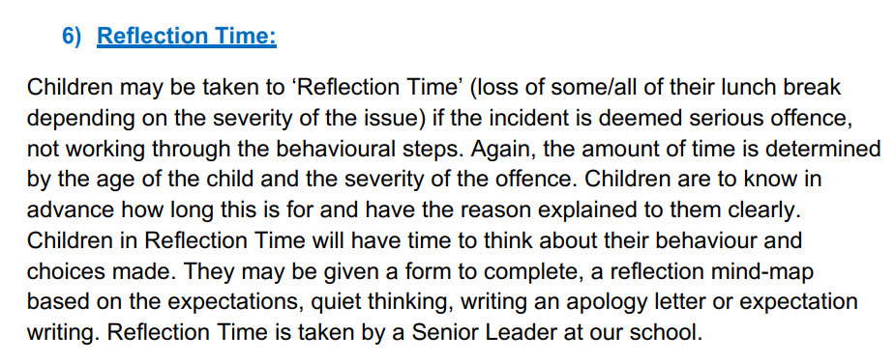
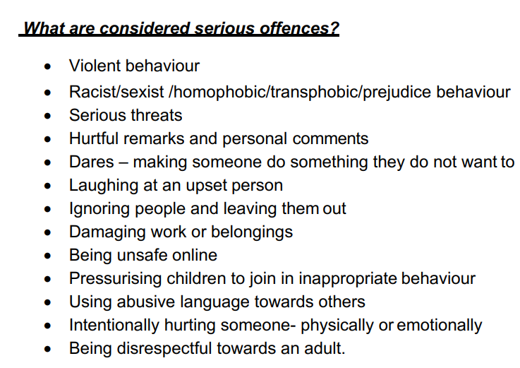
Behaviour and Expectations

Slide 21
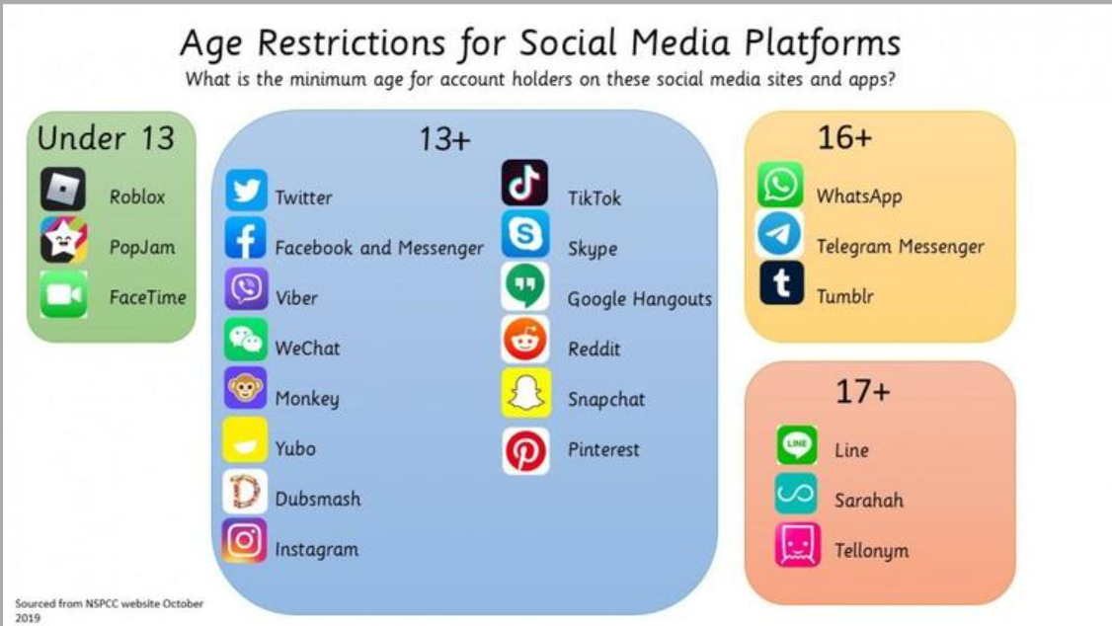
Social Media outside of school

Slide 22
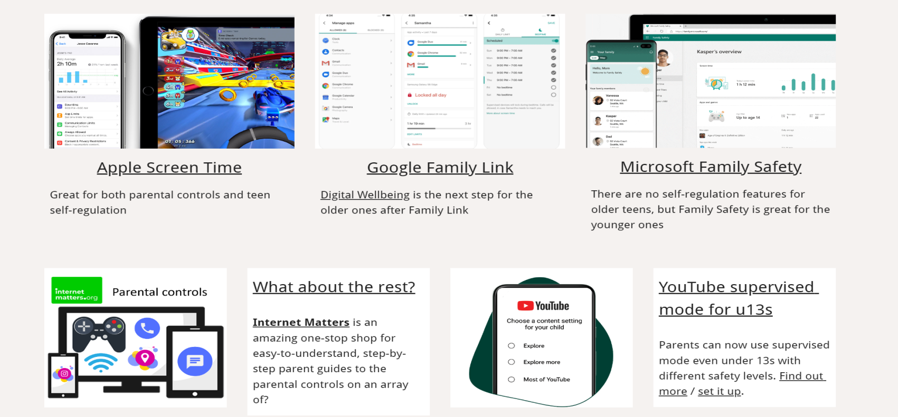
Social Media outside of school
Really useful website: https://parentsafe.lgfl.net/

Slide 23
Place 2 Be
Place 2 Be is a fantastic service that can be accessed in school. Children can choose to have talk sessions if something is worrying them and they have now launched a really useful parent website too!
https://parentingsmart.place2be.org.uk/ -

Slide 24
Catholic Life of the School
Lots of information on the school website
Prayers at school and at home (available on the website)
Wednesday Word (sharing Sunday’s Gospel with children
and families)
Attending whole school masses (see newsletters)

Slide 25
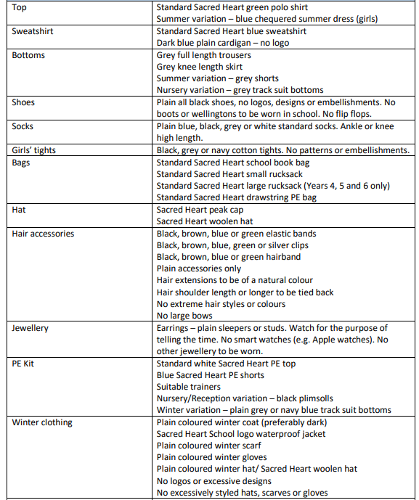
Uniform Expectations
Uniform: Plain hair accessories. Long hair must be tied back. School blue sweatshirt or dark blue cardigan must be worn. Plain all black shoes no accessories. No wellies in school.
PE Kit: White T-shirt, Blue bottoms. This will be worn on PE days.
This half term, PE days are Monday and Thursday.

Slide 26
School trips
We organise trips to support your child’s learning.
A letter will be sent out informing you of the trip and the cost if applicable.
Payment must be made and permission given using the online school money system.
We will sometimes need additional parent/carer volunteers, for trips – this will be organised by the teacher.
* Swimming takes place in Spring Term (Jan/Feb) and is over a two week block at the Caledonian Road Pool
.

Slide 27
Communicating with the teacher
Brief messages can be given at the office or to a member of staff at the gate.
Notes/letters can be sent in to the teacher.
Telephone messages can be left for the teacher.
You can make an appointment to see your child’s teacher (before school at 8:30am or after school around 3:45pm are best)
Parents’ Evening (Tuesday 1st and Thursday 3rd November)

Slide 28
At the end of the day…..
Collecting children – lessons finish at 3.30pm.
Children are led down to the back playground and are collected from there.
Please inform the office if somebody else will be collecting your child.

Slide 29
Inclusion & Pastoral care
The school Inclusion team work to minimise barriers to education and ensure that all children achieve their full potential.
If we are worried about any aspect of your child’s development we will work in collaboration with you to ensure your child’s needs are met.
In the first instance we would take action in the classroom.
If your child needs more specialist input, we will consult with the school’s Inclusion team and
if necessary appropriate external agencies to ensure they receive the best support.
If you have any concerns about your child’s development at any time, we welcome your input. Please contact your child’s class teacher in the first instance.
You may wish to discuss sensitive matters relating to your child’s welfare or development with a member of the school Inclusion team. Please contact the school office to book an appointment. The Inclusion leader is currently Miss Le Fleming.

Slide 30
Safeguarding is everyone’s responsibility
The Designated Safeguarding Lead is Mr Rodrigo.
The Deputy Safeguarding Leads are:
Mr Lane
Miss Le Fleming
Mrs McCormick
Ms Brown
Mr Fletcher
Miss Kelly

Slide 31
If you are worried about a child please speak without delay to the Designated Safeguarding Lead and in his absence one of the Deputy Safeguarding Leads.
At Sacred Heart we provide a safe environment in which children can learn. Every member of staff has a responsibility to identify children who may be in need of extra help or who are suffering, or are likely to suffer, significant harm. All staff have a responsibility to take appropriate action and follow the School’s safeguarding procedures; this may involve working with other services such as Children's Social Care as required.

Slide 32
Contact Numbers
Should we need to contact you in an emergency it is very important that school has your correct contact numbers.
Please inform the school immediately if your contact details change.

Slide 33
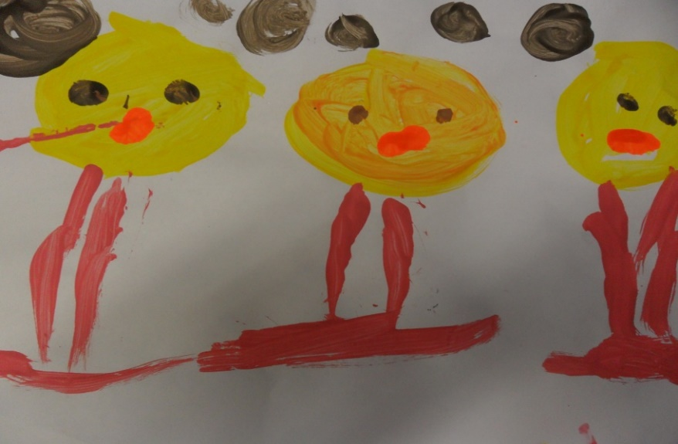
FRIENDS OF SACRED HEART (FOSH)
FOSH (Friends of Sacred Heart) will be running again this year. This is a parent committee which organises events and raises funds for the school.
This will be led by Miss Palmer – she will be in touch soon about how you can get involved!

Slide 34
Events coming up
Class assemblies
Y3 St Bernadette (Miss Walker) Friday 30th September – 9:45am (Main Building Top Hall)
Y3 St Martin (Miss Smith) Thursday 24th November - 9:45am (Main Building Top Hall)
Parents’ Evenings
Tuesday 1st November
Thursday 3rd November

