Slide 1
Parent/carer Information Meeting
12.09.22
Sacred Heart Catholic Primary School
Autumn 2022
Year 4 St Catherine Miss Jeffrey
Year St Elizabeth Miss Warner

Slide 2
School Mission Statement
E
To go forward together in Christ
To respect our neighbour
To always give of our best

Slide 3

E

Slide 4
Leadership Team
N
Mr. Lane – Executive Headteacher
Mrs McCormick – Deputy Headteacher
Miss Le Fleming, Mr Rodrigo and Ms Brown– Assistant Headteachers

Slide 5

N
Miss Ansar-LSA for both classes
Miss Badu-LSA St Catherine

Slide 6
Information
E
You can find out what is going on in school/class in several different ways:Website - www.sacredheart.islington.sch.uk
Curriculum/topic maps
Twitter account : SacredHeart_CS
Class assemblies
Parent’s evening (Autumn & Spring terms)
End of year reports (Summer Term)
Notes/letters sent home
Text messages (ensure school office has up to date details)
Weekly newsletters (and put on the school website)

Slide 7

Website
N
http://www.sacredheart.islington.sch.uk/

Slide 8
Subjects we study
E
Religious Education
English (Reading, Writing, Handwriting, Grammar, Punctuation and Spelling)
Maths
Science
History /Geography (half termly basis)
Art/Design Technology (half termly basis)
Computing
Music
Spanish
Physical Education
Personal, Social, Health, Citizenship and Emotional Education

Slide 9
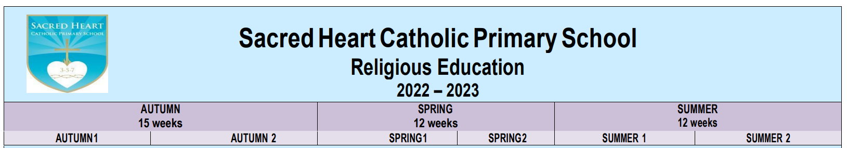
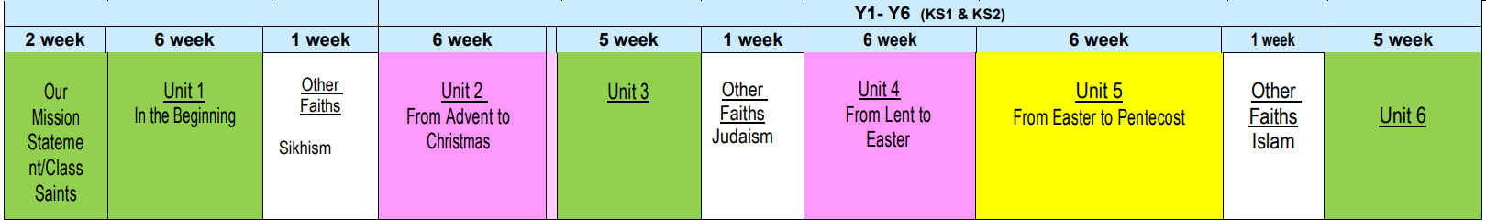
Religious Education Topics
N

Slide 10
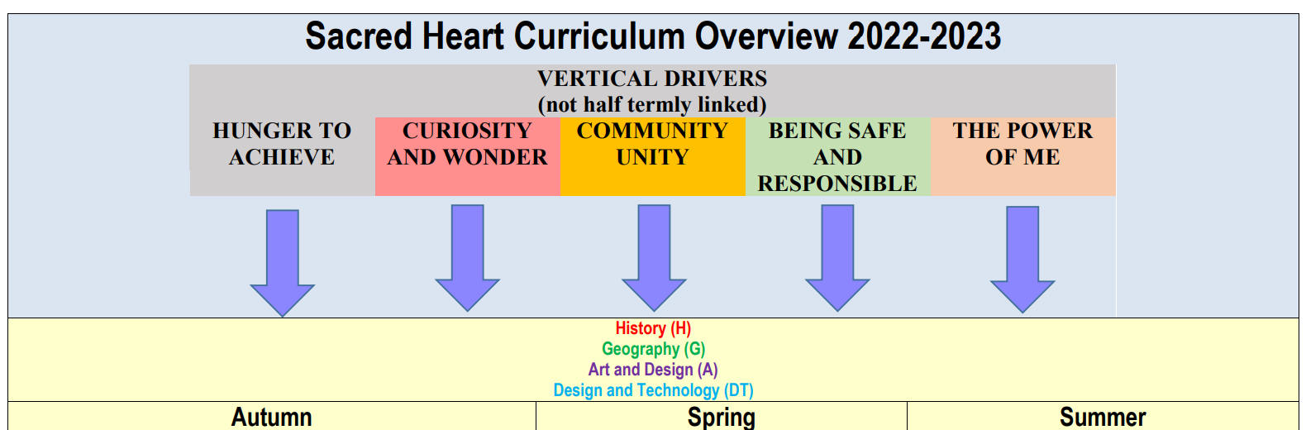
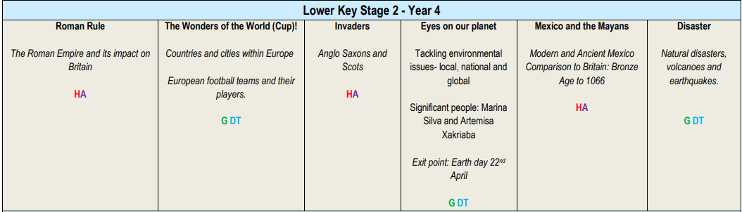
Year 4 Curriculum Topics
E

Slide 11

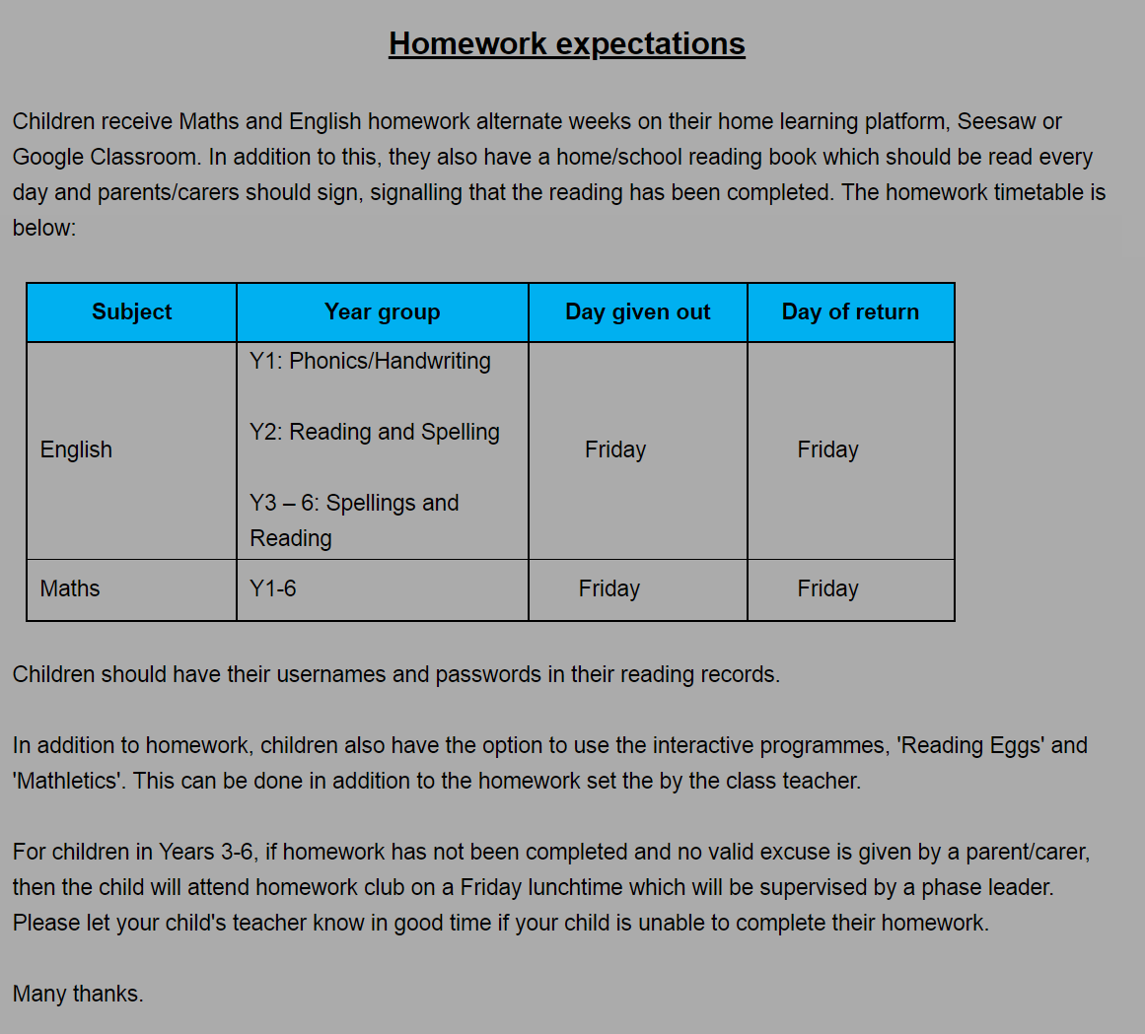
N
Homework will start on Friday 16th September

Slide 12
E
Reading
In addition to the weekly homework, the children will be expected to complete daily reading from Monday- Friday. Expectations are as follows:
LKS2 (Years 3 and 4)
10-15 minutes per night
Please ensure that you sign your child’s Reading Record daily and comment if there is something you would like the teacher to know or when responding to a comment from the teacher. Your role in your child’s development of reading is crucial so please sign the Home/school Reading agreement which you will find at the front of your child’s Reading Record.

Slide 13
Home/School reading
N
Child to read to parent and vice versa.
Parents to ask children questions about what they have read.(There are suggested questions in the ‘Helping your child with English’ document which can be found on the school website, as well as home learning resources and suggested reading lists.
Parent to sign is a must! A comment is optional although please let us know any concerns you have or anything you feel is significant about your child’s reading.
3x Book Not Signed (BNS) – Children will be asked to read during their H/W club on Friday.
Banded book levels – children should be able to read 95% of the book confidently to build up their confidence. As well as this, children need to be able to understand what they are reading.

Slide 14
E
Reading records
Please take note of the Spelling word lists as your child needs to be able to read and spell these by the end of Year 4 (at the end of the key stage).
Please read with your child when you can – even though they are older, reading aloud still benefits them!

Slide 15
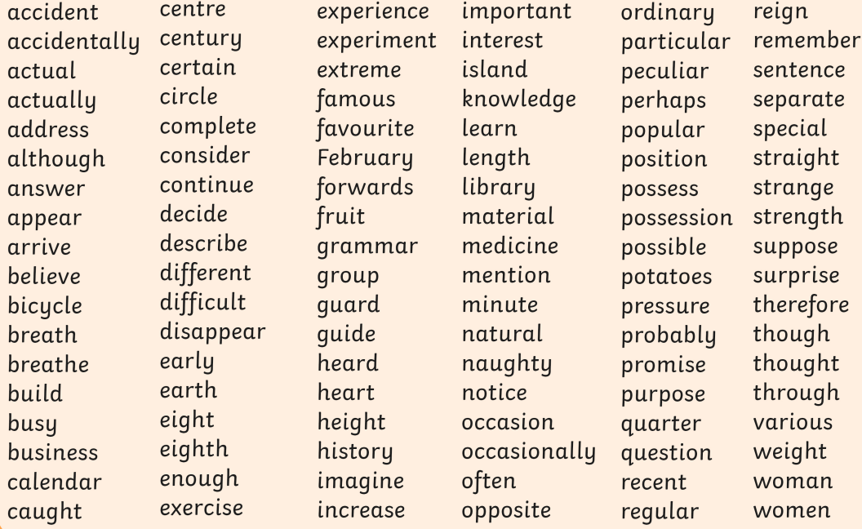
Year3-4 Statutory Spellings
E

Slide 16
Times tables
N
Children need daily practice with their times tables in order to really remember them.
They only truly know them when they can fluently recall them out of order and when they can apply them in order to solve problems.
Children practise their times tables during Maths lessons and complete times table challenges but by this stage, the children should know them so we can use the lessons to apply them in reasoning and problem solving.
There is guidance on the school website (under curriculum) for how to support your child with learning times tables
In Year 6, your child is expected to know up to 12x12 and use them in a range of calculations and problems

Slide 17
How does my child’s attendance and
punctuality affect their progress?
Children suffer academically if they are not at school – they fall behind and can find it difficult to catch up.
Children should only ever be off school if they are ill.
All pupil absences must be reported to the school immediately.
Medical and dental appointments should be made after school, where possible.
Holidays must not be taken in term time (term dates are available on the website)
Education Welfare check the attendance of every child every 6 weeks.
Where attendance is poor referrals will be made to Education Welfare.
We expect children to have 100% attendance.
Anything below 96% is a cause for concern.
Anything below 90% is a ‘persistent absentee’ and serious cause for concern.
Anything below 90% is an immediate referral to Islington, who we have to liaise with regarding advice around poor attendance.
Anything between 90-95% is monitored closely.
Please help your child achieve their best by sending them to school every day.
N

Slide 18
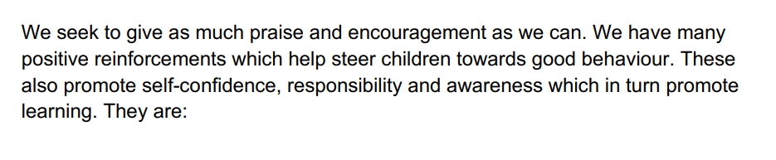
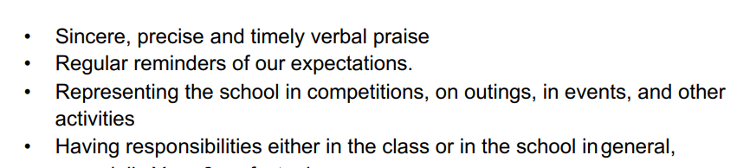
Behaviour and Expectations
E

Slide 19
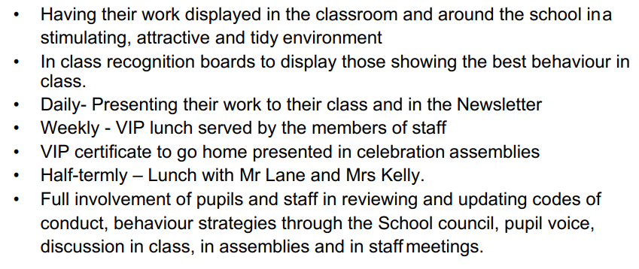
Behaviour and Expectations
N

Slide 20
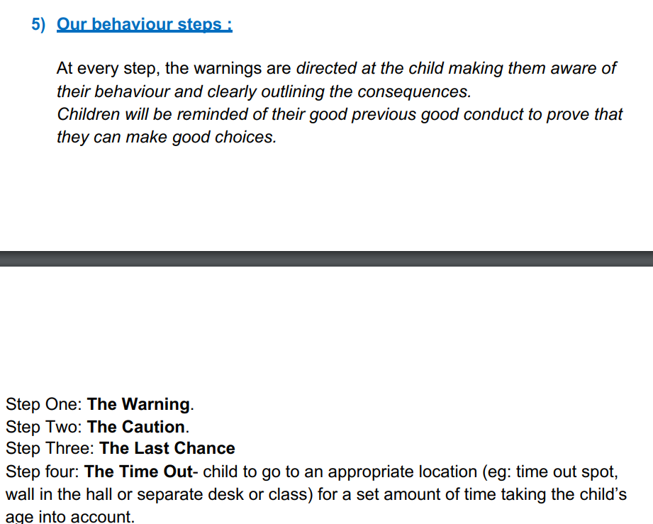
Behaviour and Expectations
E

Slide 21
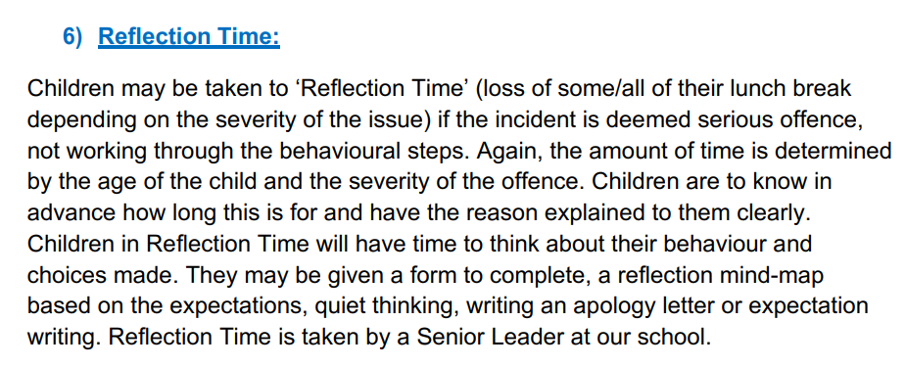
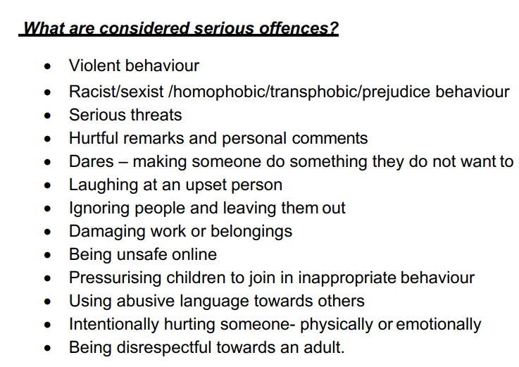
Behaviour and Expectations
N

Slide 22
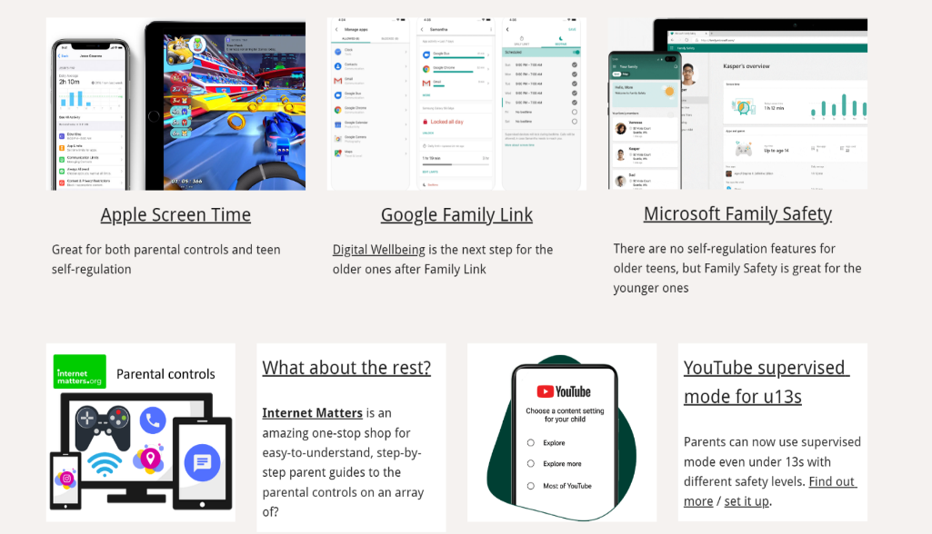
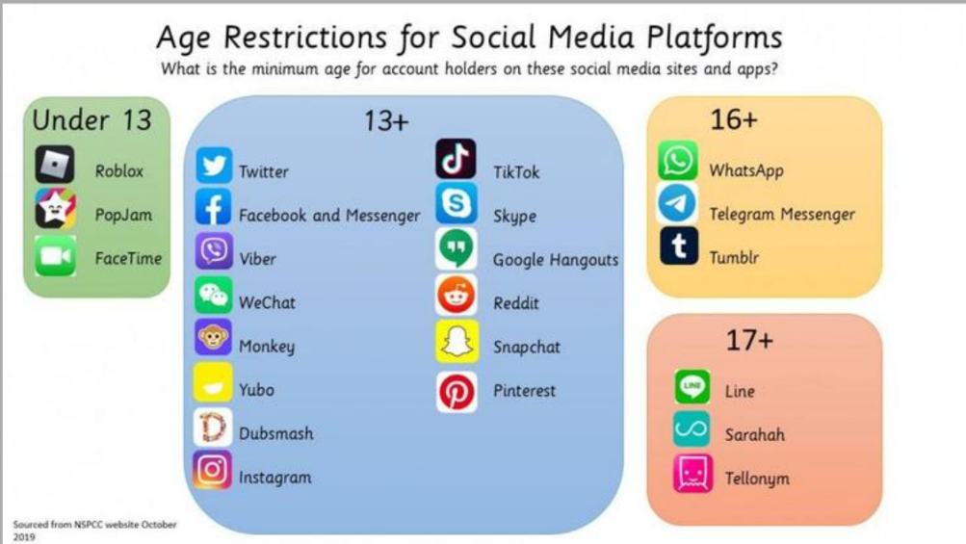
Social Media outside of school
E
Really useful website: https://parentsafe.lgfl.net/

Slide 23
Statutory Assessments
N
All statutory assessments take place in the Summer Term
Multiplication check-children will take a timed multiplication/times table check in June and be given a mark out of 25.
Results will be published within their end of year report.

Slide 24
N
Catholic Life of the School
Lots of information on the school website
Prayers at school and at home (available on the website)
Wednesday Word (sharing Sunday’s Gospel with children
and families)
Attending whole school masses (see newsletters)
Attending class masses (Wednesdays, see newsletters)

Slide 25
Uniform Expectations
E
Uniform: No coloured hair accessories. Long hair must be tied back. School blue sweatshirt or dark blue cardigan must be worn. Plain all black shoes no accessories. No wellies in school. Sacred Heart cap or woollen hat.
PE Kit: White T-shirt, Blue bottoms. This will be worn on PE days.
This half term, PE days are Wednesdays and Fridays.

Slide 26
School trips
We organise trips to support your child’s learning.
A letter will be sent out informing you of the trip and the cost if applicable.
Payment must be made and permission given using the online school money system.
We will sometimes need additional parent/carer volunteers, for trips – this will be organised by the teacher.
N

Slide 27
Communicating with the teacher
E
Notes/letters can be sent in to the teacher.
Telephone messages can be left for the teacher.
You can make an appointment to see your child’s teacher (before school at 8:30am or after school around 3:45pm are best)
Parents’ Evening (Tuesday 1st and Thursday 3rd November)

Slide 28
N
At the end of the day…..
Collecting children – lessons finish at 3.30pm.
Children are led down to the front playground and are collected from there.
Please inform the office if somebody else will be collecting your child.

Slide 29
E
Inclusion & Pastoral care
The school Inclusion team work to minimise barriers to education and ensure that all children achieve their full potential.
If we are worried about any aspect of your child’s development we will work in collaboration with you to ensure your child’s needs are met.
In the first instance we would take action in the classroom.
If your child needs more specialist input, we will consult with the school’s Inclusion team and
if necessary appropriate external agencies to ensure they receive the best support.
If you have any concerns about your child’s development at any time, we welcome your input. Please contact your child’s class teacher in the first instance.
You may wish to discuss sensitive matters relating to your child’s welfare or development with a member of the school Inclusion team. Please contact the school office to book an appointment. The Inclusion leader is currently Miss Le Fleming.

Slide 30
Safeguarding is everyone’s responsibility
N
The Designated Safeguarding Lead is Mr Rodrigo.
The Deputy Safeguarding Leads are:
Mr Lane
Miss Le Fleming
Mrs McCormick
Ms Brown
Mr Fletcher
Miss Kelly

Slide 31
E
If you are worried about a child please speak without delay to the Designated Safeguarding Lead and in her absence one of the Deputy Safeguarding Leads.
At Sacred Heart we provide a safe environment in which children can learn. Every member of staff has a responsibility to identify children who may be in need of extra help or who are suffering, or are likely to suffer, significant harm. All staff have a responsibility to take appropriate action and follow the School’s safeguarding procedures; this may involve working with other services such as Children's Social Care as required.

Slide 32
Contact Numbers
N
Should we need to contact you in an emergency it is very important that school has your correct contact numbers.
Please inform the school immediately if your contact details change.

Slide 33
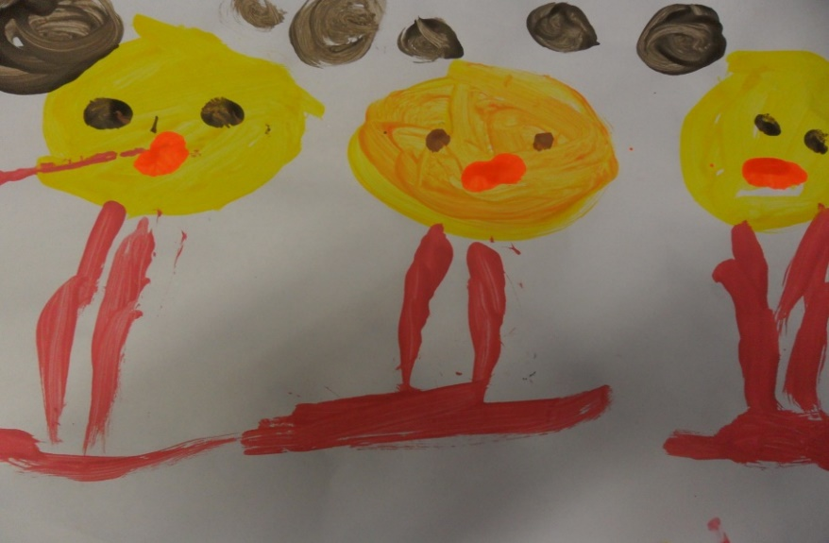
FRIENDS OF SACRED HEART (FOSH)
E
FOSH (Friends of Sacred Heart) will be running again this year. This is a parent committee which organises events and raises funds for the school.
This will be led by Miss Palmer – she will be in touch soon about how you can get involved!

Slide 34
Events coming up
Class assemblies
Y4 St Elizabeth (Miss Warner)-Friday 23rd September 9:45am. Theme-RE
Y4 St Catherine (Miss Jeffrey)-Friday 21st October 9:45am. Theme-History
Parents’ Evenings
Tuesday 1st November
Thursday 3rd November
N

