Slide 1

Reading and spelling

Slide 2

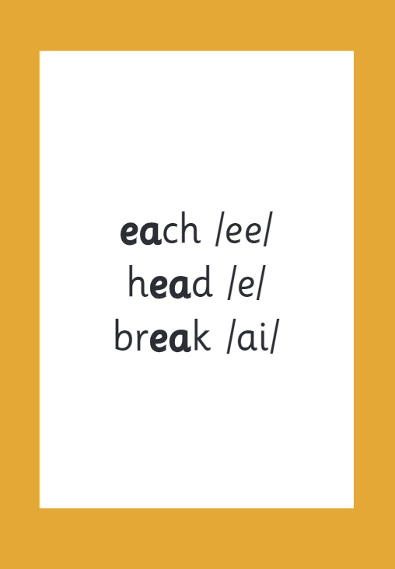
Reading and spelling
Notes:
This is an example of what the children learn in Year 1.
Children learn that there are graphemes that can have different sounds and sounds that can be made with different letters.
Use the backs and fronts of Phase 5 cards to show ‘ea’ and ‘ow’.

Slide 3
And all the different ways to write the phoneme sh:
shell
chef
special
caption
mansion
passion

Slide 4
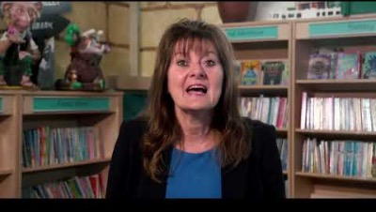
Tricky words
Notes:
Have a look at this video on the website: https://www.littlewandlelettersandsounds.org.uk/resources/for-parents/

Slide 5

Spelling
Say the word.
Segment the sounds.
Count the sounds.
Write them down.
Notes:
Model the process on a flipchart for the parents to see.

Slide 6
How do we teach reading in books?
Reading practice sessions are:
timetabled three times a week
taught by a trained teacher/teaching assistant
taught in small groups.
Notes:
The children read the same book three times in a week. The first time we work on decoding (sounding out) the words, the second time we work on prosody which is reading with expression – making the book sound more interesting with our story-teller voice or our David Attenborough voice – and the third time we look at comprehension. We read the books three times at school because we want to develop the fluency. The more they see words the more they begin to read them automatically without having to sound them out.

Slide 7
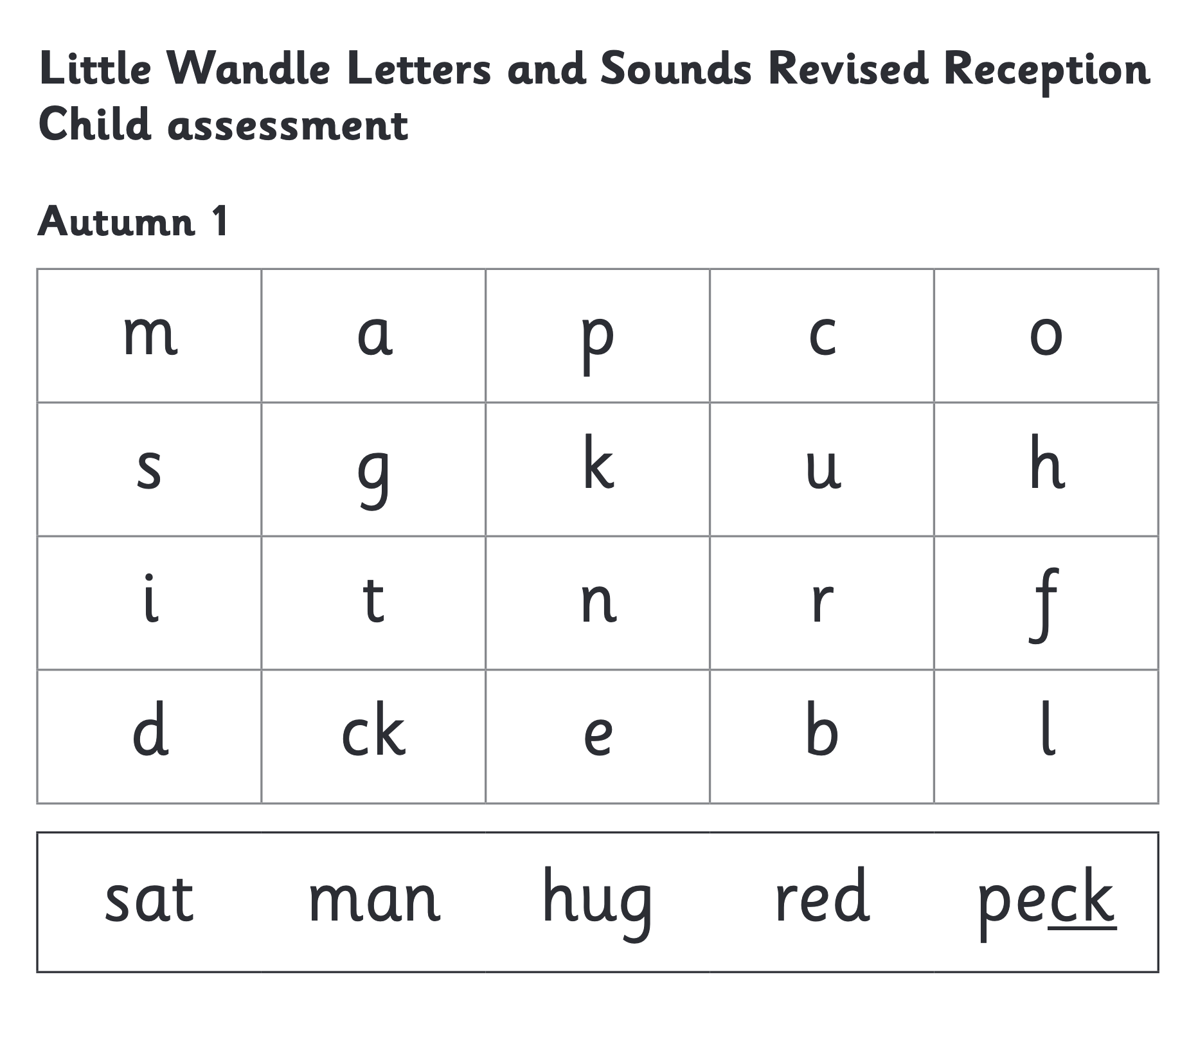
We use assessment to match your child the right level of book
Notes:
We assess your child every six weeks to check progress. Any child who needs extra support has daily keep-up sessions planned for them.

Slide 8
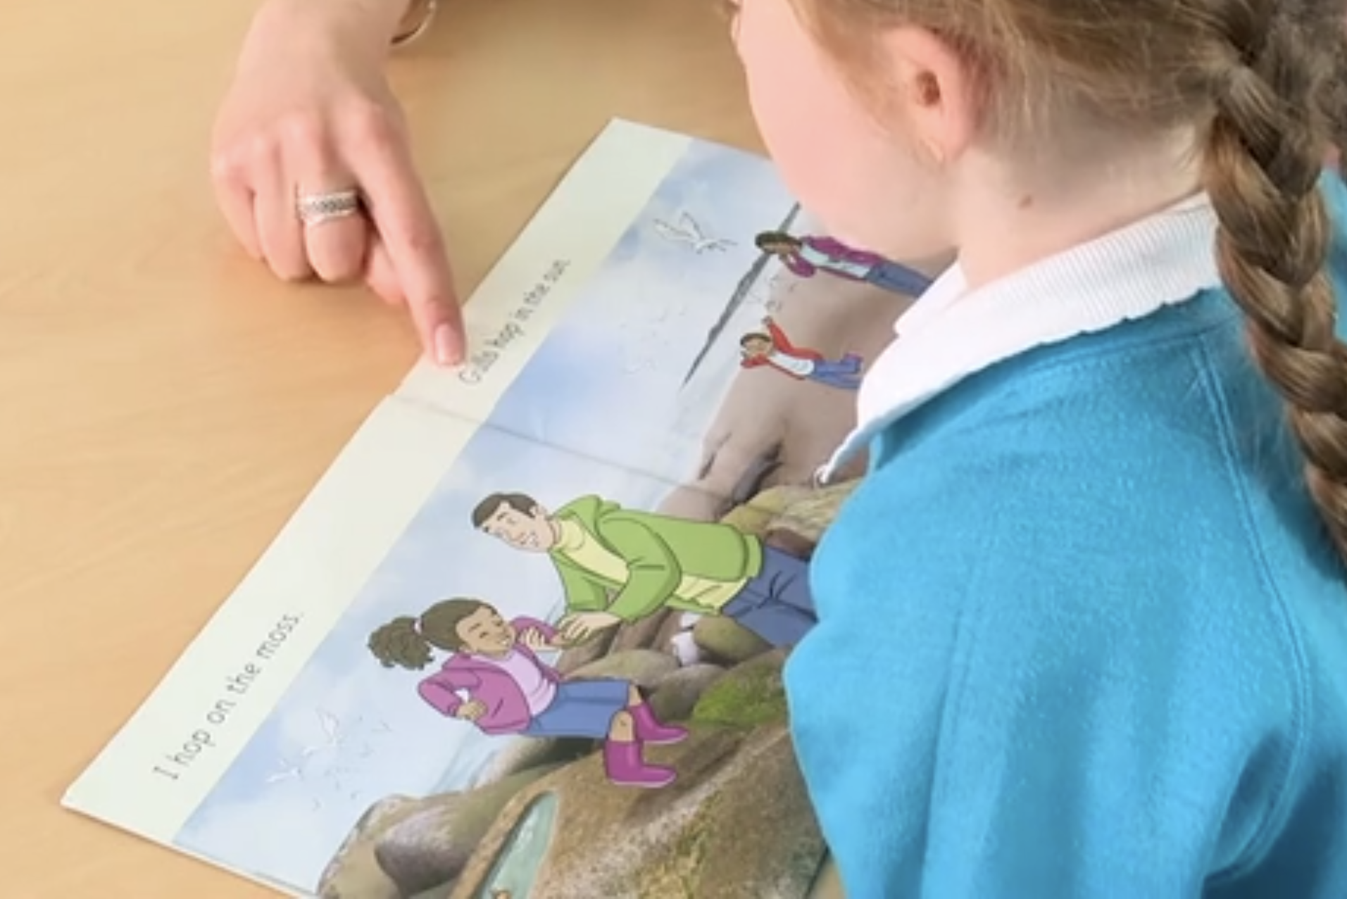
Reading a book at the right level
This means that your child should:
Know all the sounds and tricky words in their phonics book well
Read many of the words by silent blending (in their head) – their reading will be automatic
Only need to stop and sound out about 5% of the words by the time they bring the book home – but they should be able to do this on their own.

Slide 9
Reading at home

Slide 10
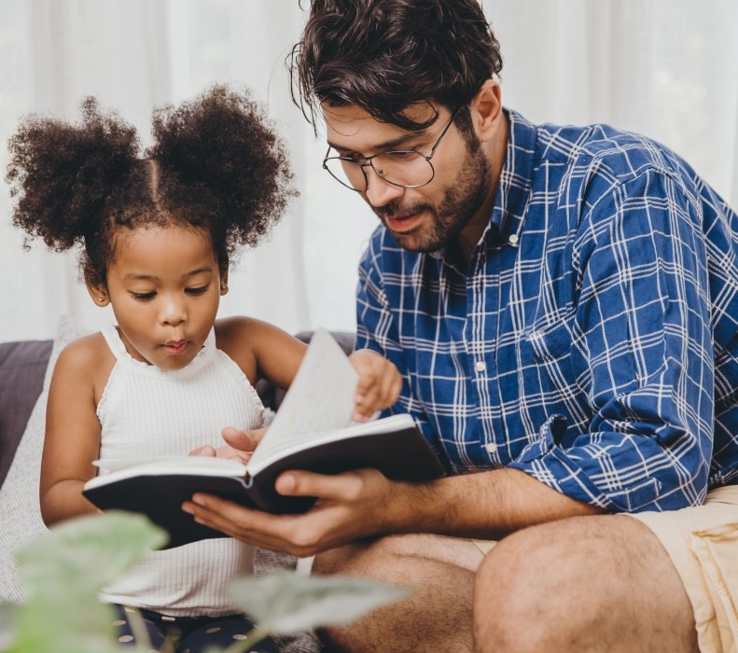
The most important thing you can do is read with your child
Reading a book and chatting had a positive impact a year later on children’s ability to…
understand words and sentences
use a wide range of vocabulary
develop listening comprehension skills.
The amount of books children were exposed to by age 6 was a positive predictor of their reading ability two years later.
Parental involvement in the development of children’s reading skills: A five-year longitudinal study (2002) Senechal, M. and Lefvre, J
Notes:
Celebrate child’s success at school, make time for reading at home!

Slide 11

Books going home
Notes:
As well as the ‘learning to read’ book that your child will bring home they will also bring home a book for sharing with you. This book is SO important. This is how we are going to give them the WILL to read. Please read with your child as often as you can – at least once a day if possible.

