Slide 1
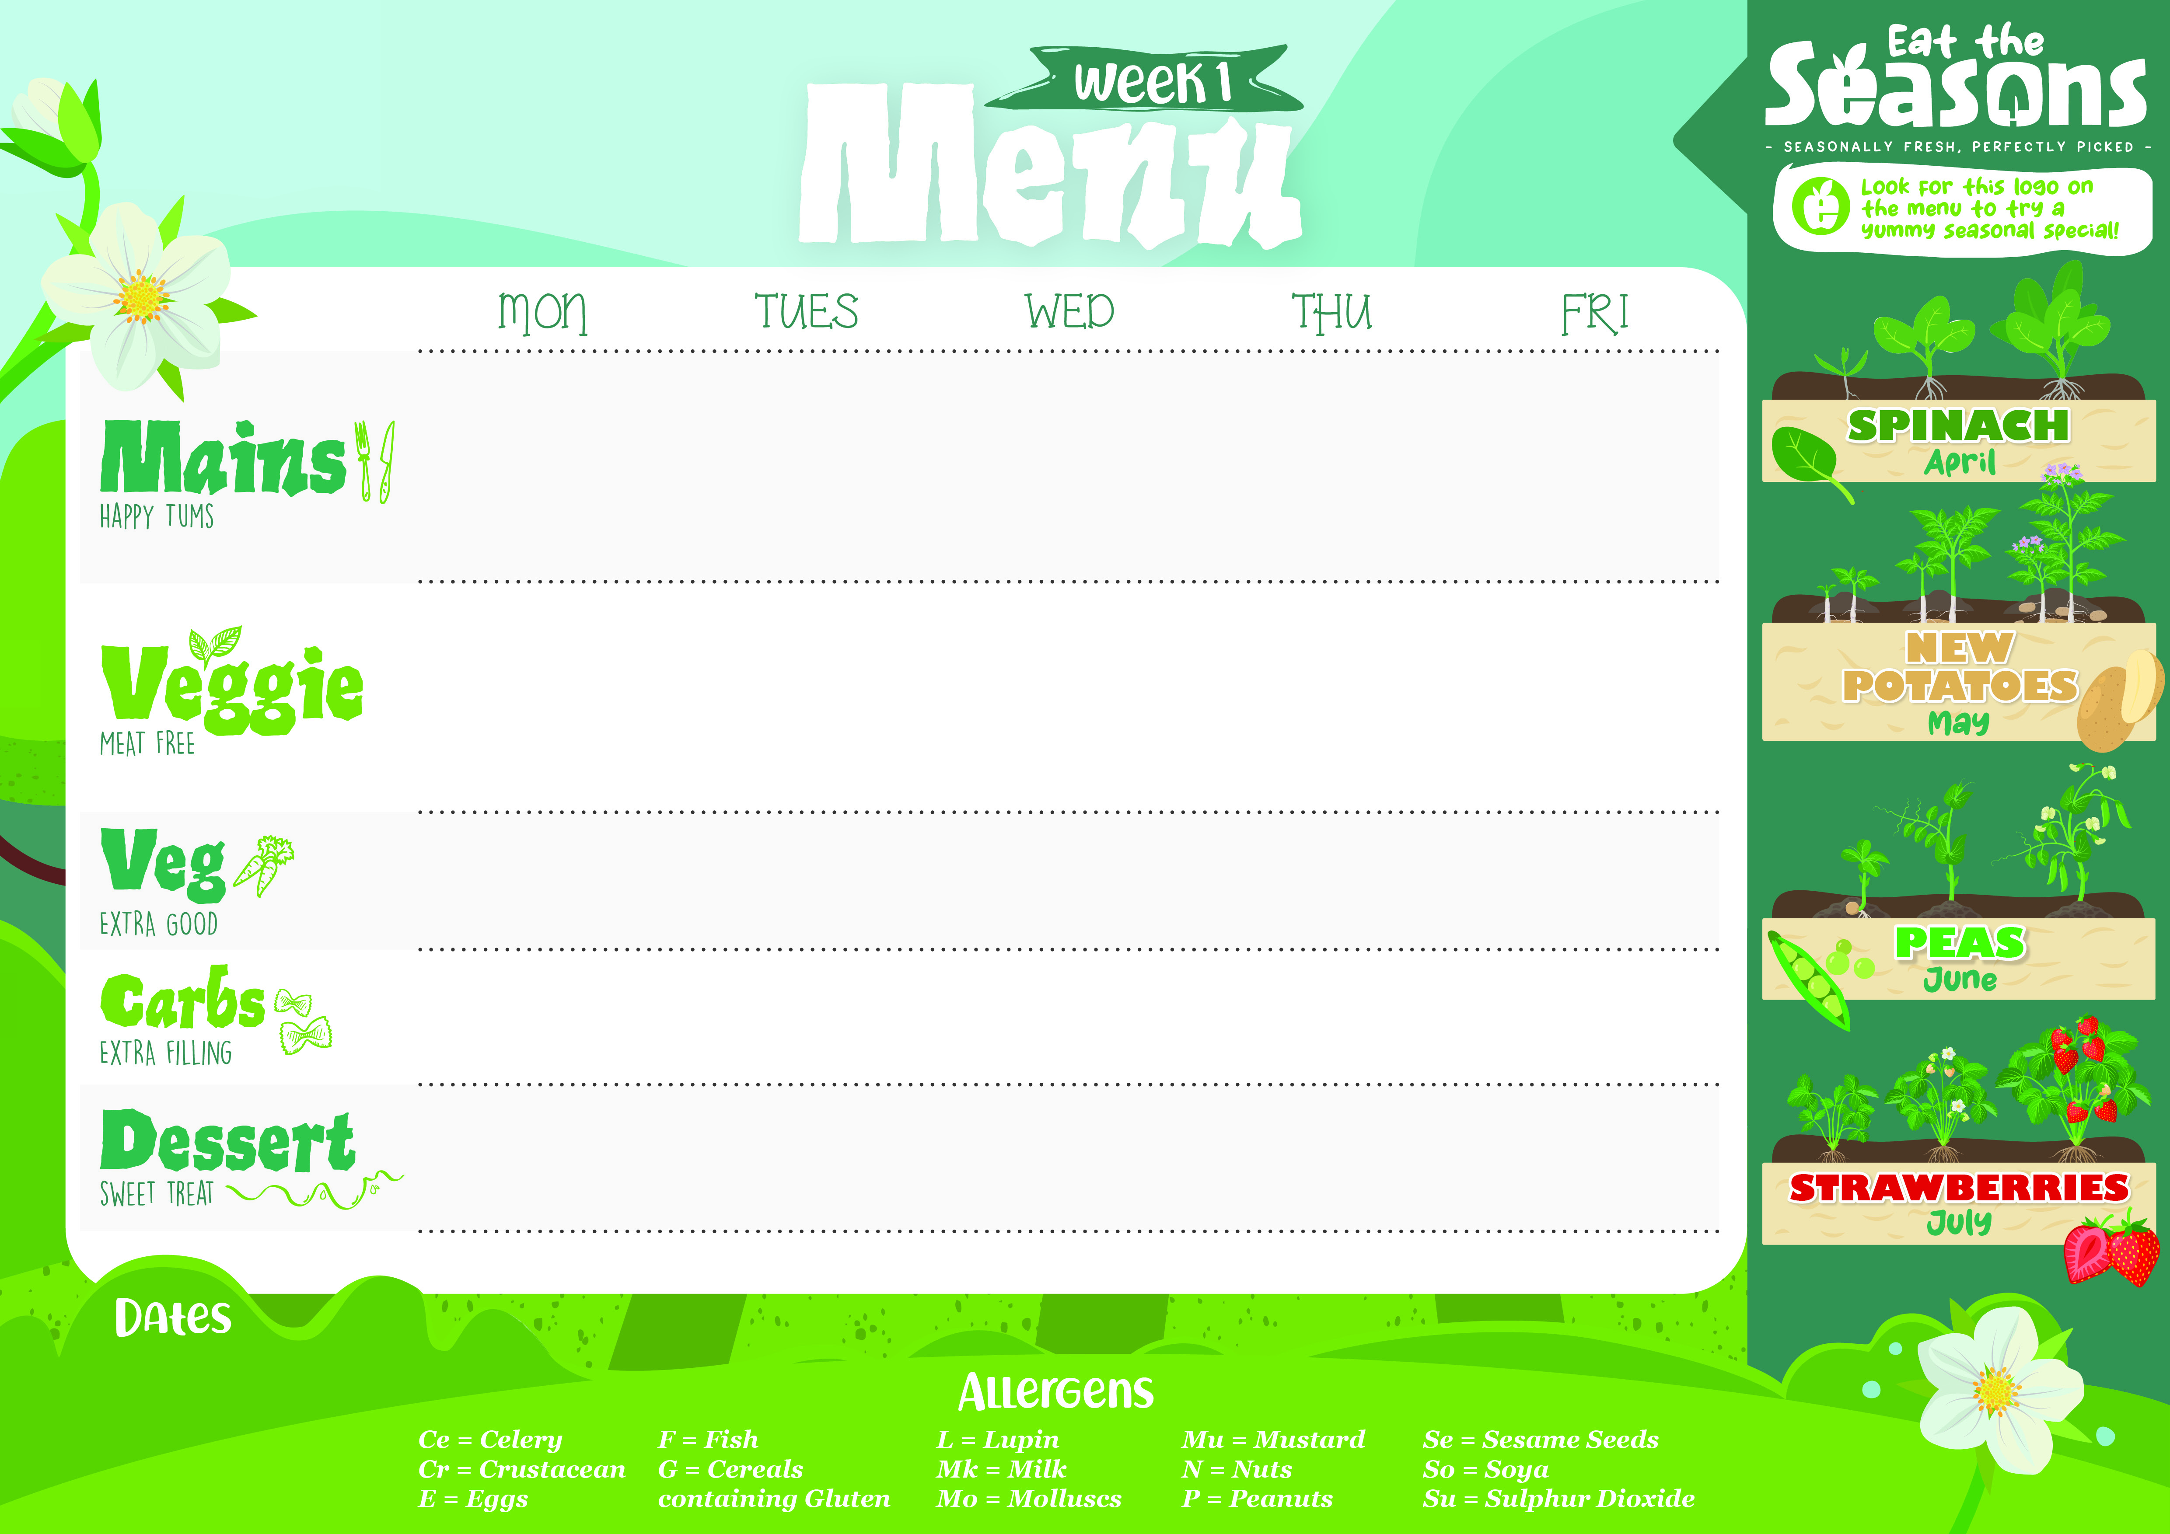

Sticky BBQ Chicken (G,So) | Pepperoni and Mozzarella Pizza (G,Mk) | Roast Turkey Breast with Gravy and Cranberry Sauce | Mild Mexican Beef Chilli Con Carne | Fish Finger with Lemon Wedge (G,F)
Vegan Sticky BBQ Pieces (G,So) | Roast Vegetable and Mozzarella Pizza (G,Mk) | Homemade Pea, Spinach and Cheddar Cheese Quiche (G,E,Mk) | Mild Vegetable Chilli Non-Carne | Veggie Fingers (G,)
Baby Carrots Fresh Roasted Courgette | Garden Salad | Fresh Cauliflower Green Beans | Sweetcorn Fresh Broccoli Florets | Garden Peas Baked Beans
Savoury Tomato Rice | Crispy Potato Wedges | Roasted New Potatoes | Brown Rice | Oven Baked Chips
Pineapple Upside Down Cake (G,E,Mk,So) | Fresh Fruit or Yoghurt (Mk,So) | Fresh Fruit or Yoghurt (Mk,So) | Fresh Fruit or Yoghurt (Mk,So) | Lemon Blondie with Lemon Glaze (G,E)
Jacket Potatoes, salad bar, cold desserts and fresh fruit available daily.
21/4/25 12/5/25 9/6/25 30/6/25 21/7/25

Slide 2

Mild Chicken Curry | Wholemeal Penne Pasta with Beef (G,Mk) | Thyme Roast Chicken with Gravy | Chicken Sausage with Onion gravy (G,Su) | Fish Finger with Lemon Wedge (G,F)
Mild Vegetable Curry | Potato Gnocchi with a Tomato and Roasted vegetable sauce (G,Mk) | Spinach and Feta Spanakopita (G,E,Mk) | Vegetarian Sausage with Onion Gravy (G,Ce) | Mixed Bean and Vegetable Burrito (G,Mk,Mu)
Garden Peas Lightly Spiced Cauliflower (Mu) | Fresh Broccoli Sweetcorn | Roast Carrots Fresh Spring Greens and Leek | Cauliflower Green Benas | Garden Peas Baked Beans
Brown Rice | Home Baked Garlic Focaccia (G) | Roasted New Potatoes | Mashed Potato | Oven Baked Chips
Strawberry Jam Sponge (G,E,Mk,Su) | Fresh Fruit or Yoghurt (Mk,So) | Fresh Fruit or Yoghurt (Mk,So) | Fresh Fruit or Yoghurt (Mk,So) | Banana and Date Flapjack (G)
Jacket Potatoes, salad bar, cold desserts and fresh fruit available daily.
28/4/25 19/5/25 16/6/25 7/7/25

Slide 3

Wholemeal Penne with Fajita Chicken, Tomato Sauce and Peppers (G,Mk,Mu) | Beef Burger in a Soft Bun with Tomato Relish (G,Se) | Thyme Roasted Chicken with Gravy | Soft Tacos and Slow Cooked Beef with Salsa and Sour Cream (G,Mk,Su) | Fish Finger with Lemon Wedge (G,F)
Macaroni Cheese Pasta (G,Mk) | Vegetarian Burger in a Soft Bun with Tomato Relish (G,So,Se) | Cheesy Leek and Carrot Crumble (G,Mk) | Veggie quesadilla with Sour Cream and Salsa (Ce,G,Mk,Mu) | Veggie Fingers with Tartar Sauce (G,So,Se)
Chefs Salad Fresh Cauliflower | Classic Coleslaw (E,Mk,Mu,Su) Sweetcorn | Green Beans Fresh Carrots | Classic Coleslaw (E,Mk,Mu,Su) Sweetcorn | Garden Peas Baked Beans
Home Baked Garlic Focaccia (G) | Potato Wedges | Roasted New Potatoes | Sweet Potato Wedges | Oven Baked Chips
Chocolate Marble Cake (G,E,Mk,So) | Fresh Fruit or Yoghurt (Mk,So) | Fresh Fruit or Yoghurt (Mk,So) | Fresh Fruit or Yoghurt (Mk,So) | Apricot Sponge (G,E,Su)
Jacket Potatoes, salad bar, cold desserts and fresh fruit available daily.
5/5/25 2/6/25 23/6/25 14/7/25

