Slide 1
Teach reading: change lives
Parent workshop: Phonics and early reading

Slide 2

Phonics

Slide 3

Little Wandle Letters and Sounds Revised
Our school has chosen
Little Wandle Letters and Sounds Revised as our systematic, synthetic phonics (SSP) programme to teach early reading and spelling.

Slide 4
Phonics is:
making connections between the sounds of our spoken words and the letters that are used to write them down.
Notes:
It sounds complicated but it really isn’t!

Slide 5

Blending to read words
Notes:
Some children learn to blend really quickly, and others take a little longer. If your child is finding it difficult, ask your child’s teacher for ways to help at home – playing blending games at home is so helpful!
Show parents this video from the website: https://www.littlewandlelettersandsounds.org.uk/resources/for-parents/

Slide 6
Terminology
Phoneme
Split vowel digraph
Grapheme
Blend
Digraph
Segment
Trigraph
Notes:
Explain what each word means – use our glossary to help: https://www.littlewandlelettersandsounds.org.uk/resources/my-letters-and-sounds/getting-started/

Slide 7


Teaching order
Notes:
We usually teach four new sounds a week and have a review lesson on a Friday. You will get a list of the sounds that we are learning to have at home. This will help you with formation and pronunciation.

Slide 8


Gradually your child learns the entire alphabetic code:
Notes:
We will work our way through the whole Little Wandle Programme until your child can read fluently.

Slide 9

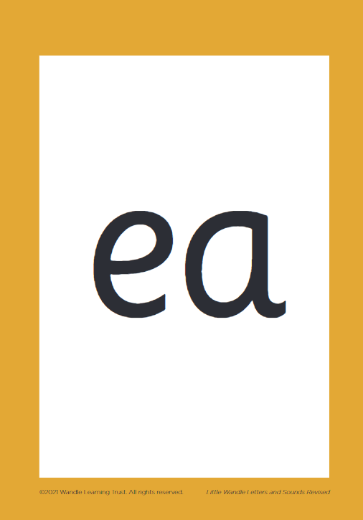
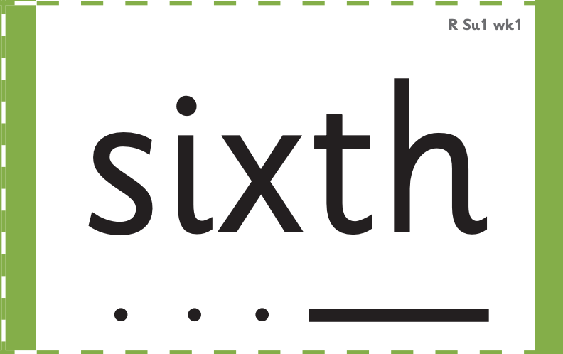



How we make learning stick
Notes:
There are specific resources for the Little Wandle Programme which the children will be very familiar with. Each sound that we teach to begin with has either a mnemonic (like the astronaut that you can see here) or a phrase like boing-boing for ‘oi’. This helps the children recognise and remember the graphemes. Every time we teach a new sound, we also read words during the phonics lesson that contain that new sound so that the children practise what they have learned. We then go on to reading a sentence containing some of those words. We have displays in the classroom and on the tables to support the children throughout the day.

Slide 10

We use assessment to match your child the right level of book
Notes:
We assess your child every six weeks to check progress. Any child who needs extra support has daily keep-up sessions planned for them.

Slide 11

Reading a book at the right level
This means that your child should:
Know all the sounds and tricky words in their phonics book well
Read many of the words by silent blending (in their head) – their reading will be automatic
Only need to stop and sound out about 5% of the words by the time they bring the book home – but they should be able to do this on their own.

