Slide 1
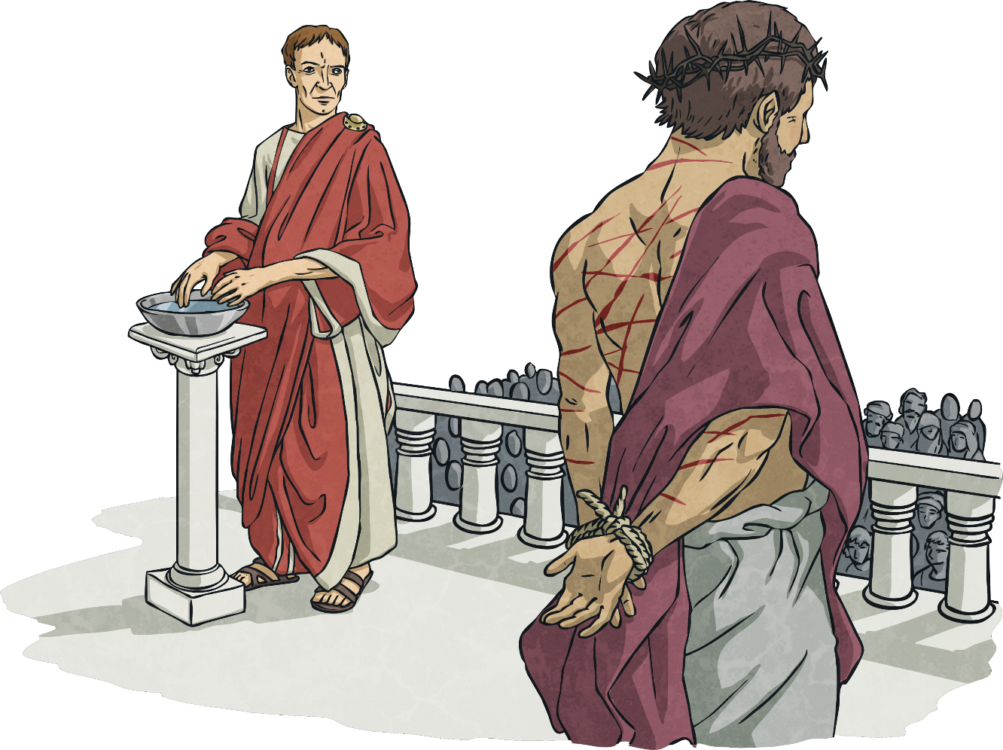
First Station:
Jesus is condemned to death.

Slide 2
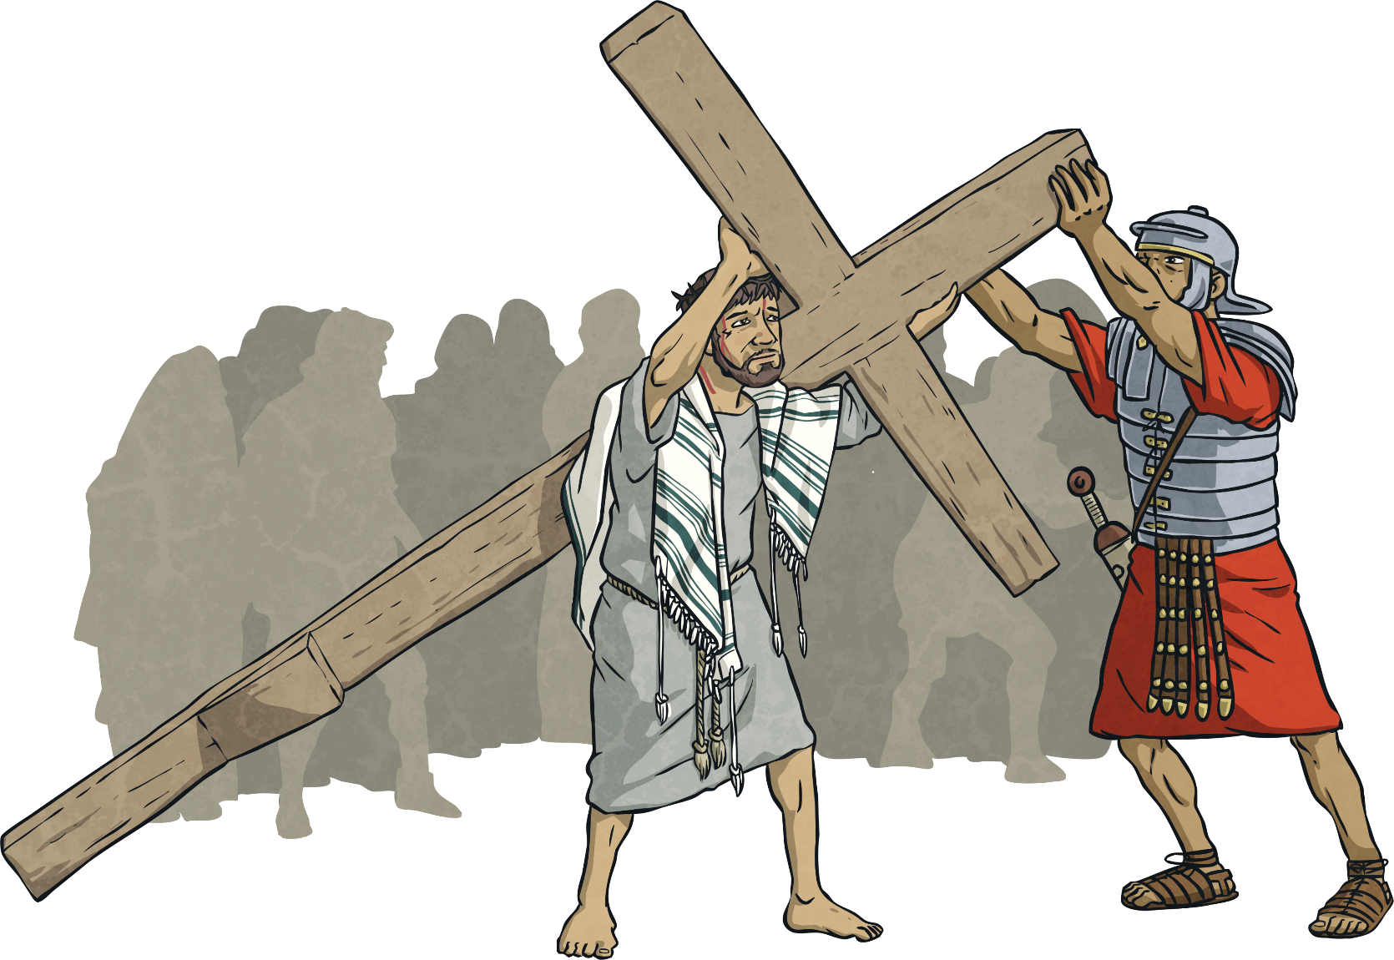
Second Station: Jesus carries the cross.

Slide 3
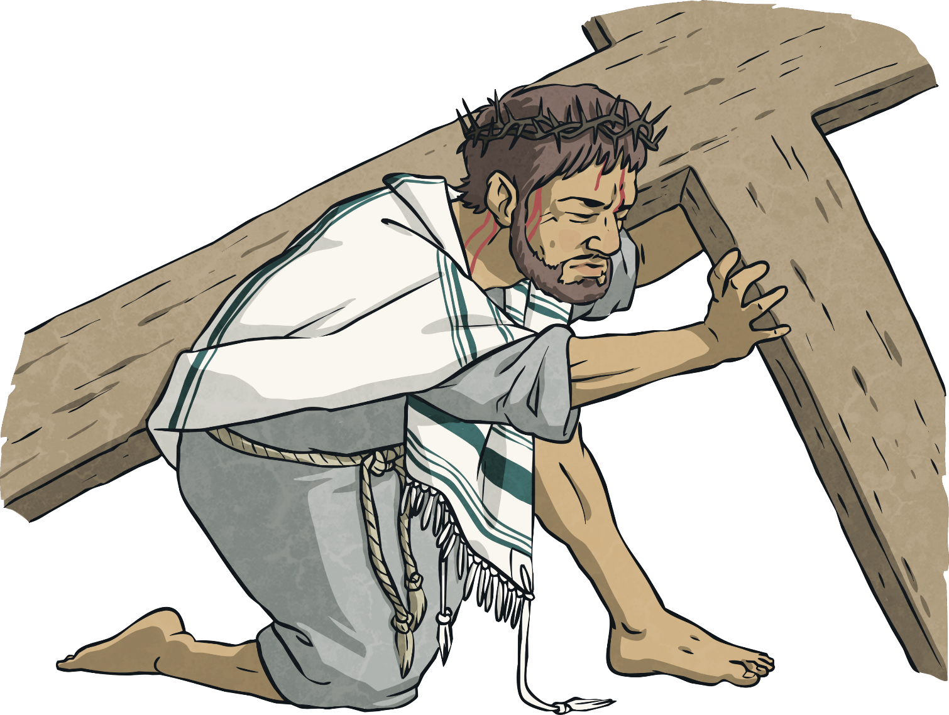
Third Station:
Jesus falls for the first time.

Slide 4
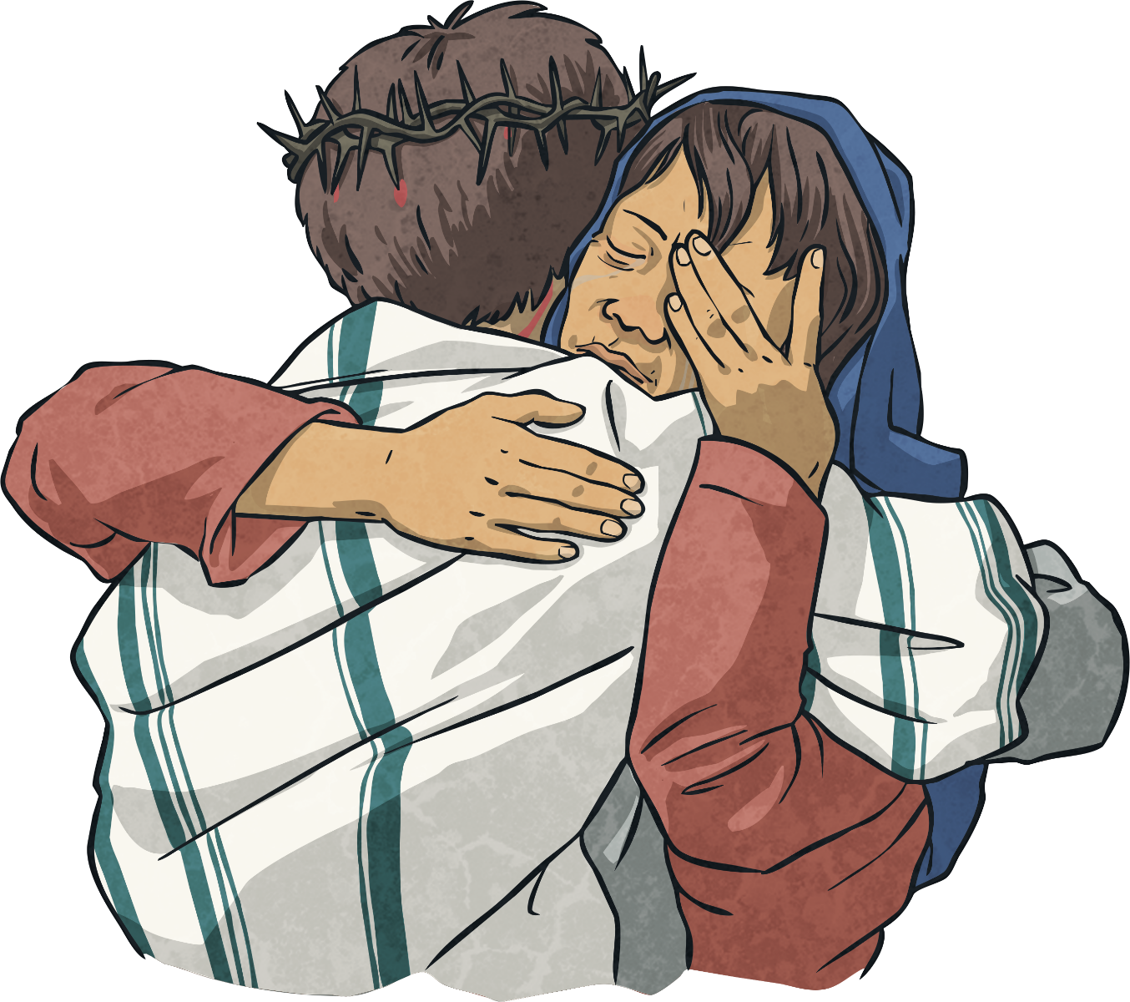
Fourth Station:
Jesus meets his mother, Mary.

Slide 5
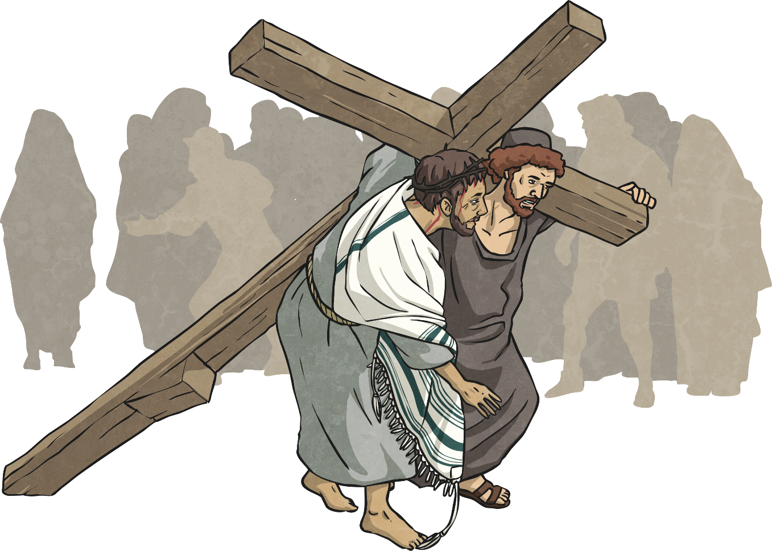
Fifth Station:
Simon of Cyrene helps Jesus carry the cross.

Slide 6
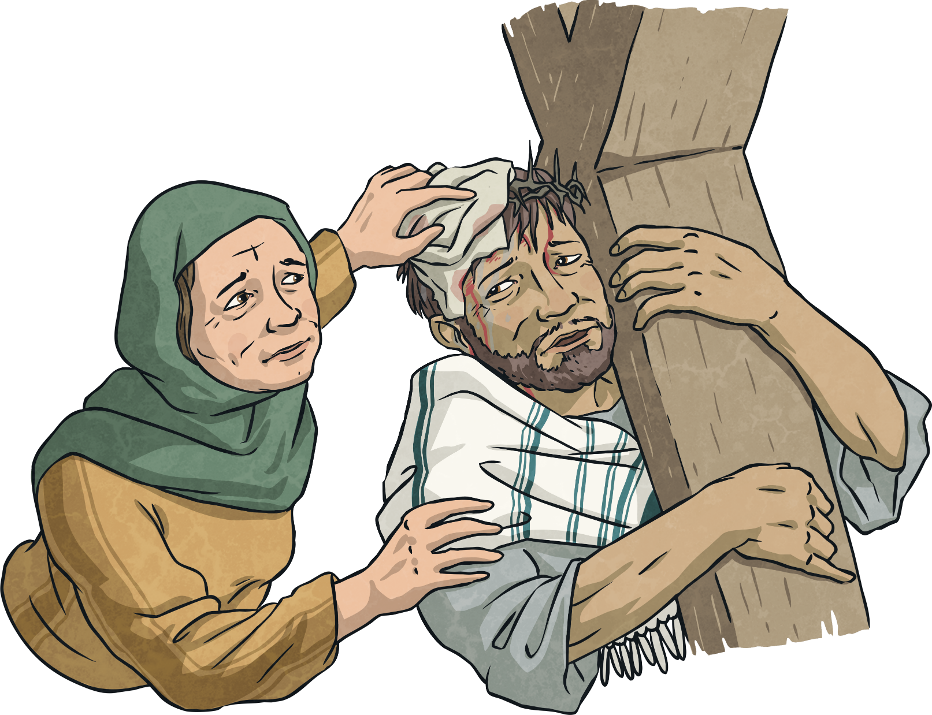
Sixth Station:
Veronica wipes the face of Jesus.

Slide 7
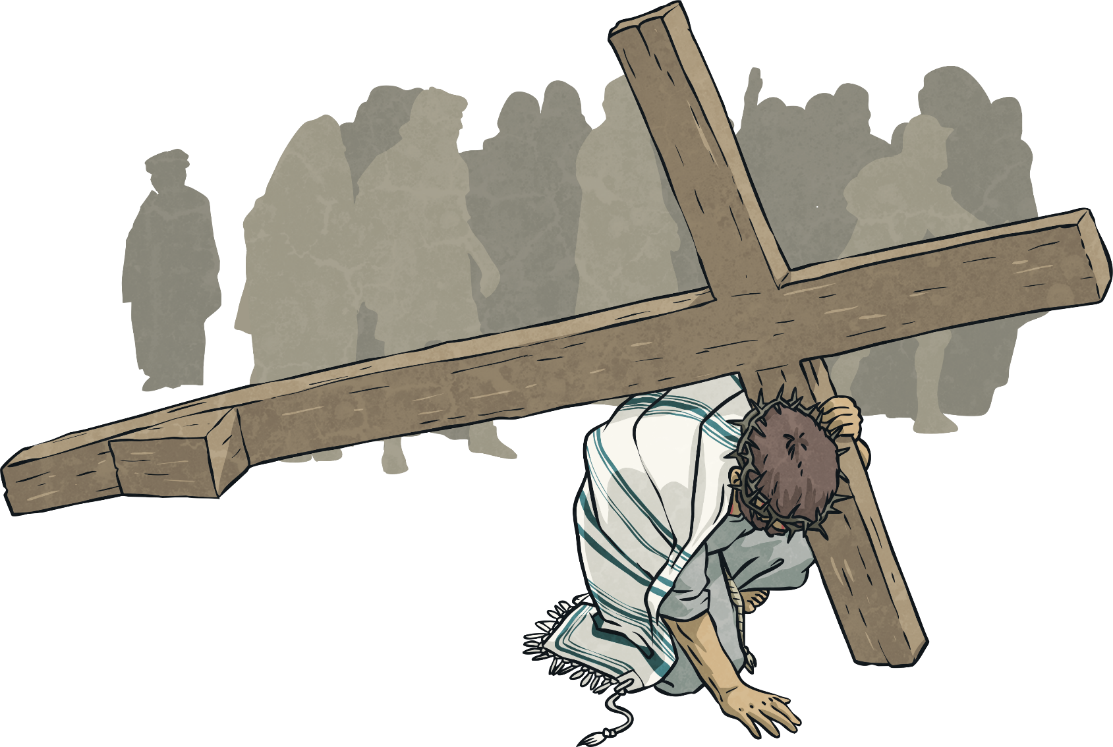
Seventh Station:
Jesus falls for the second time.

