Slide 1
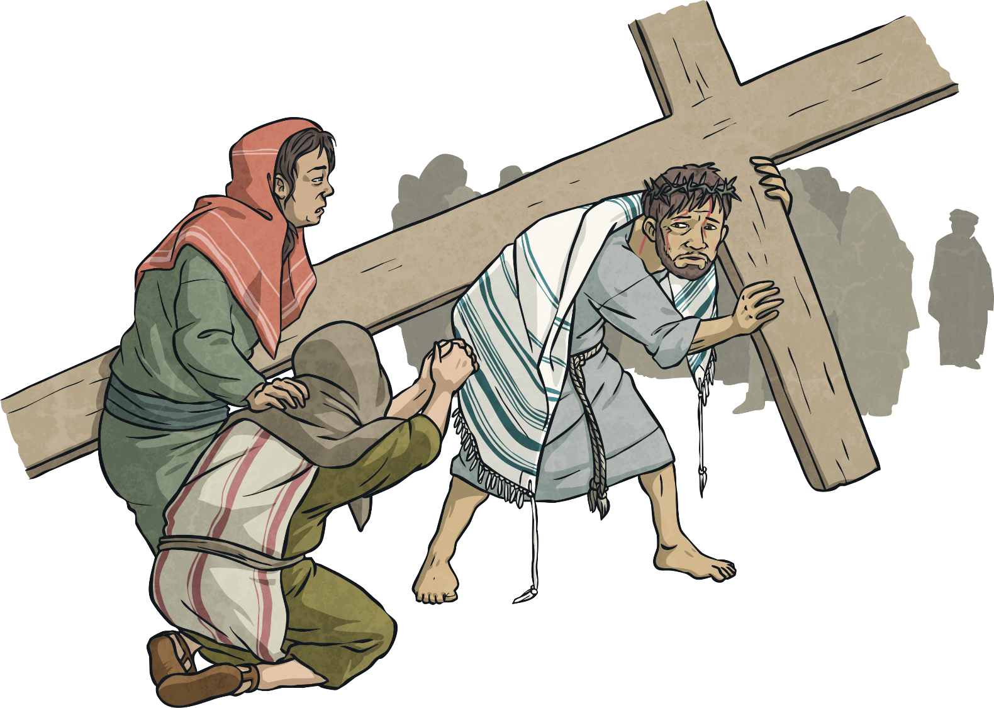
Eighth Station:
Jesus meets the women of Jerusalem.

Slide 2
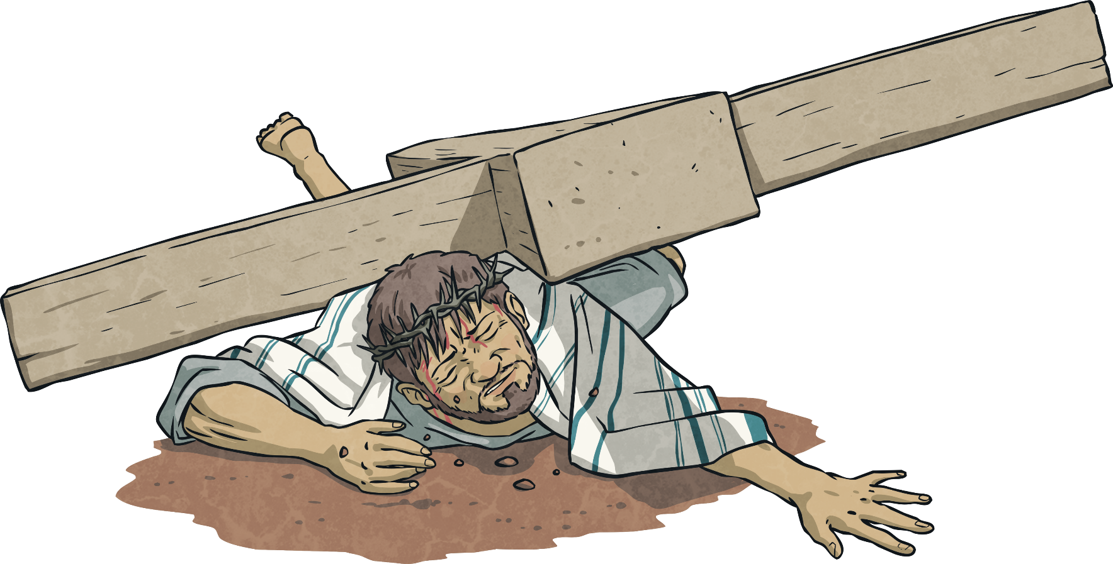
Ninth Station:
Jesus falls for the third time.

Slide 3
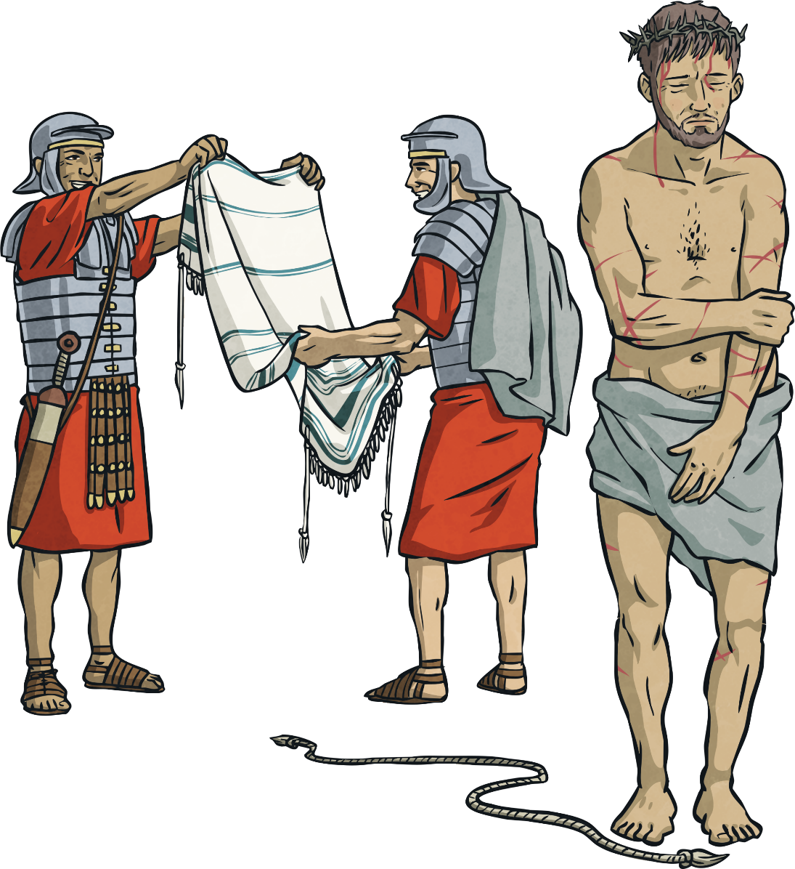
Tenth Station:
Jesus is stripped of his clothes.

Slide 4
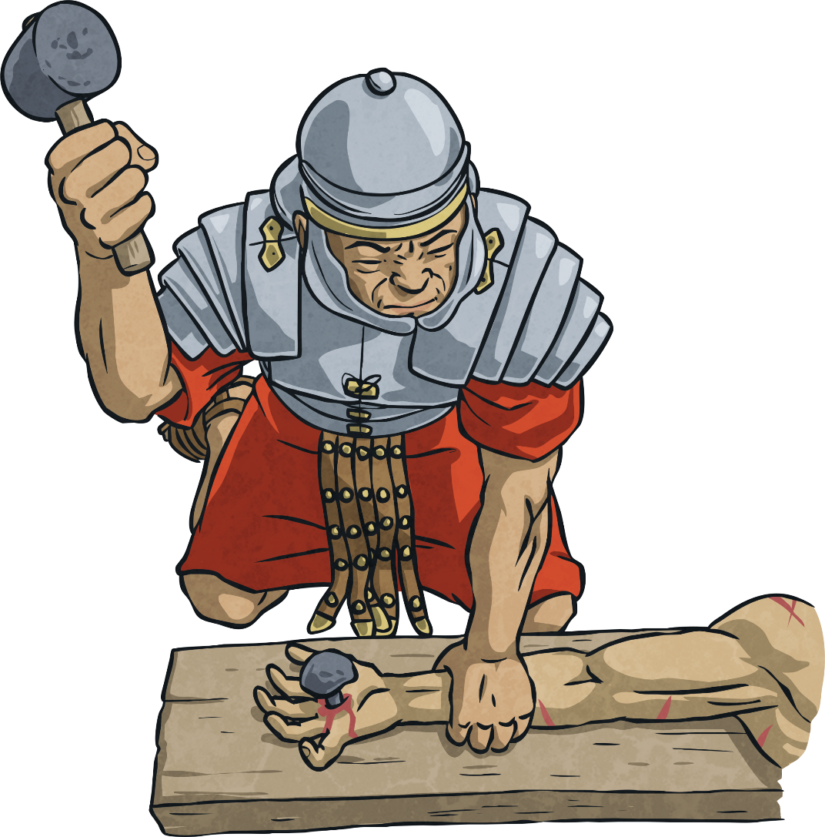
Eleventh Station:
Jesus is nailed to the cross.

Slide 5
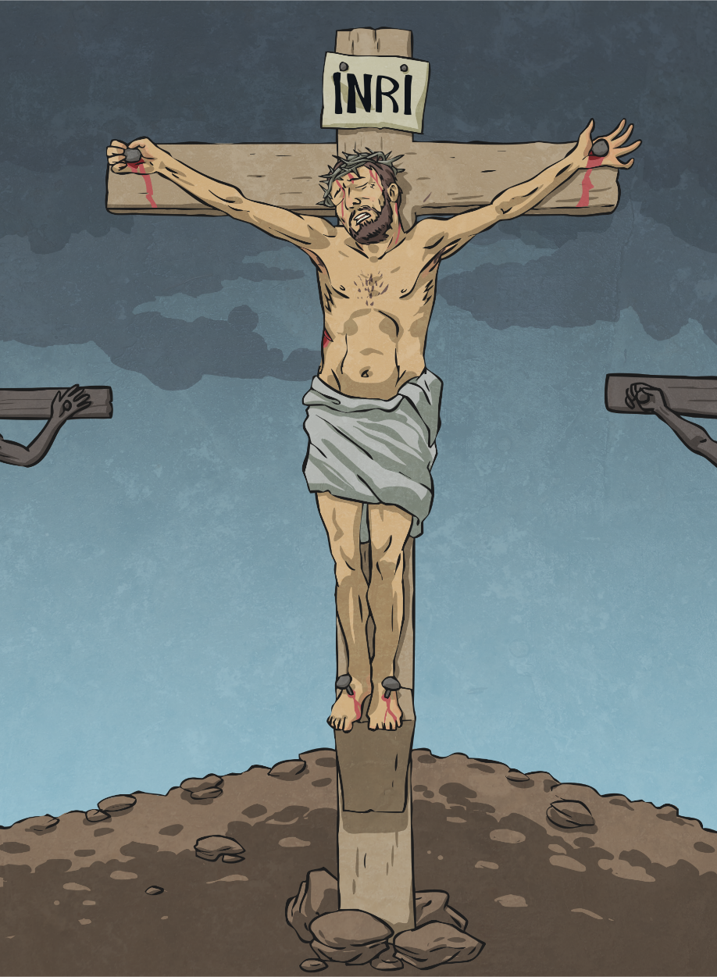
Twelfth Station:
Jesus dies on
the cross.

Slide 6
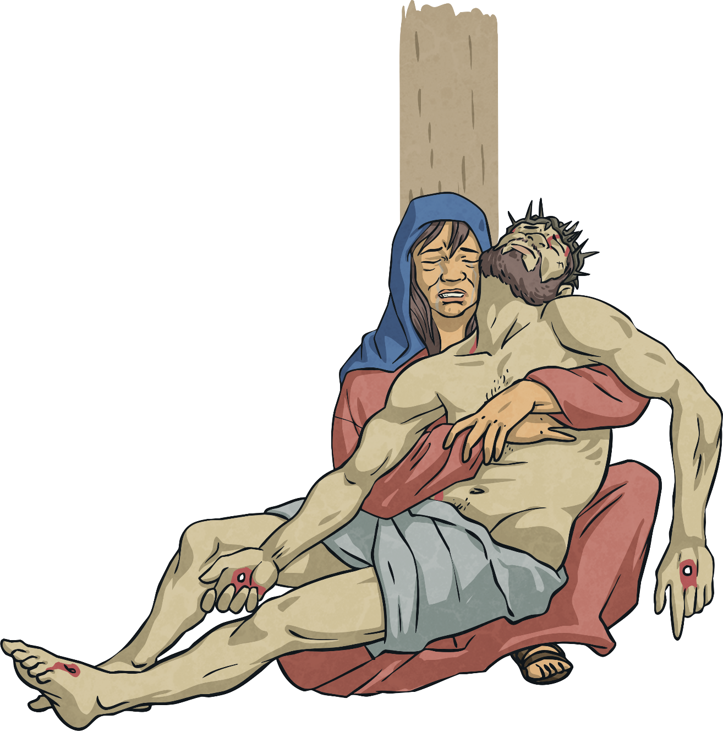
Thirteenth Station:
The body of Jesus is taken down from the cross.

Slide 7
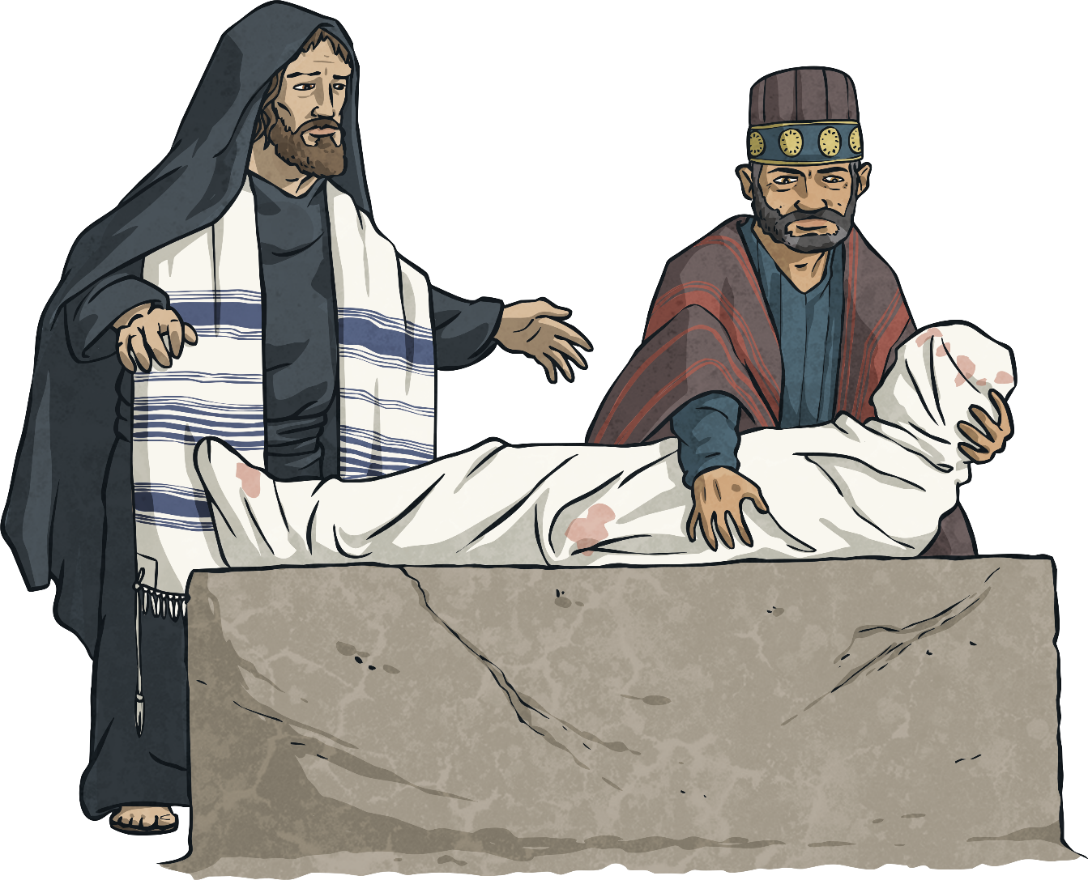
Fourteenth Station:
Jesus is laid in
the tomb.

